Slide 1
Hotel Management system
Professor by
Dr. zipping lu

Slide 2
Team
Sandeep Anumula - S02057678
Srinivas Madala - S02060306
Sai Prashanth Reddy Dyapa - S02060447
Ruthik Juvva - S02060044
Akash Badavath - S02059991
Purushottam Reddy Tippani - S02058159

Slide 3
Contents
Project Analysis
Alternate Solution Analysis
Project Design
Development
Integration and Testing
Implementation
Final Evaluation
Future Work
Conclusion

Slide 4
PROJECT ANALYSIS

Slide 5
Introduction
Hotel management is a multifaceted discipline that encompasses various aspects of overseeing and operating hospitality establishments. From managing front desk operations and housekeeping to overseeing food and beverage services and maintaining guest satisfaction, hotel management professionals play a crucial role in ensuring smooth and efficient hotel operations.
The importance of effective hotel management cannot be overstated, as it directly impacts guest experiences, revenue generation, and the overall success of the hotel. With the hospitality industry evolving rapidly and facing challenges such as changing consumer preferences and technological advancements, hotel managers must adapt and innovate to stay competitive. Technology plays a significant role in modern hotel management, enabling automation, enhancing guest services, and improving operational efficiency. Hotel managers must also stay abreast of industry trends, regulatory requirements, and best practices to maintain high standards of service and meet guest expectations. Ultimately, successful hotel management requires a combination of strategic planning, strong leadership, excellent communication skills, and a passion for delivering exceptional guest experiences.

Slide 6
Objective
Hotel management encompasses a wide range of responsibilities aimed at ensuring the smooth operation of hospitality establishments. From managing guest reservations and coordinating housekeeping services to overseeing food and beverage operations and maintaining facility upkeep, hotel management professionals play a critical role in delivering exceptional guest experiences. Effective hotel management involves strategic planning to optimize occupancy rates, enhance revenue streams, and maximize profitability. Additionally, hotel managers must prioritize guest satisfaction by providing personalized services, resolving issues promptly, and ensuring a safe and comfortable environment for guests. Operational efficiency is another key objective of hotel management, achieved through efficient resource allocation, staff training, and the implementation of technology solutions to streamline processes. Maintaining brand reputation and upholding industry standards are also essential objectives, as they contribute to long-term success and competitiveness in the hospitality market. Overall, the primary goal of hotel management is to create memorable experiences for guests while achieving business objectives and ensuring the sustainable growth of the hotel.

Slide 7
Functional Requirements
Reservation Management: Efficiently manage guest reservations, including booking, modification, and cancellation.
Room Assignment: Facilitate room allocation based on guest preferences and availability.
Check-in and Check-out Process: Streamline the process for guests to check in, verify identification, make payments, and receive room keys.
Housekeeping Management: Manage cleaning schedules, maintenance requests, and inventory for housekeeping supplies.

Slide 8
Non-Functional Requirement
Performance: Ensure responsiveness and scalability to handle concurrent users.
Security: Implement robust measures to protect guest information and payment data.
Reliability: Maintain system uptime and data integrity to prevent disruptions in hotel operations.
Usability: Provide an intuitive user interface for staff members to navigate efficiently.

Slide 9
SDLC
The Software Development Life Cycle (SDLC) is a systematic approach used to develop software applications, consisting of a series of distinct stages. It begins with project planning and requirements gathering, where the goals, scope, and specifications of the software are defined. This is followed by system design, where the architecture, modules, and components of the software are outlined. The next phase is implementation, where the actual coding and programming of the software take place based on the design specifications. Subsequently, the software undergoes testing to identify and rectify any defects or errors. Once testing is complete, the software is deployed or released to users for their use. Post-deployment, the software enters the maintenance phase, where updates, enhancements, and bug fixes are applied as needed to ensure its continued functionality and relevance. Throughout the SDLC, careful documentation and communication are essential to ensure stakeholders are informed and involved in the process, leading to the successful development and delivery of the hotel management software.

Slide 10
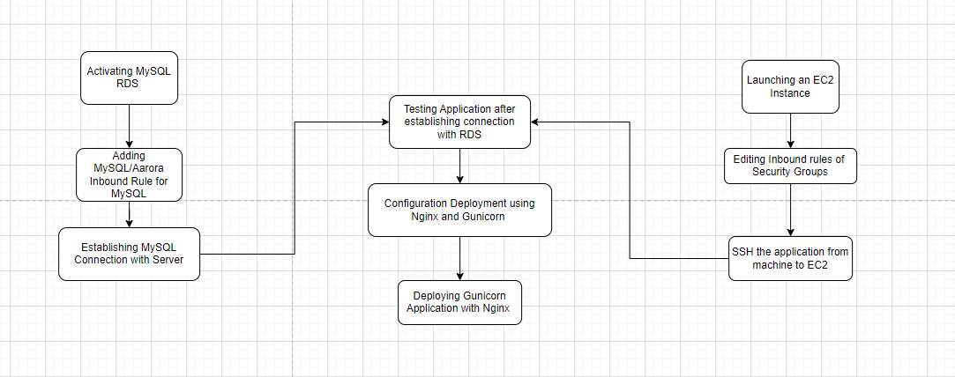
PROJECT ANALYSIS

Slide 11
Operating System
We can configure this project on following operating system.
Windows : This project can easily be configured on windows operating system. For running this project on Windows system, you will have to install Python 3.7, PIP, Django.
Linux : We can run this project also on all versions of Linux operating system
Mac : We can also easily configured this project on Mac operating system.

Slide 12
Tools and Technologies
Software used:
MySQL Work Bench
Visual Studio code.
Tools Used:
Python(Django Framework)
HTML
CSS
Bootstrap

Slide 13
Modules
A hostel management system is a comprehensive software solution designed to streamline the administrative processes involved in managing student accommodations. From room reservations to billing and maintenance, this system automates and organizes various tasks to ensure efficient hostel operations. By providing a centralized platform for managing student data, room allocations, and facility maintenance, hostel management systems enhance the overall experience for both students and administrators. These systems typically feature modules for reservation management, room allocation, billing and invoicing, student profiles, housekeeping management, inventory tracking, security and access control, complaints and feedback, reporting and analytics, and integration with academic systems. By integrating these functionalities, hostel management systems improve transparency, communication, and accountability, ultimately leading to better student satisfaction and operational efficiency. With customizable features and user-friendly interfaces, these systems cater to the specific needs of individual hostels while adhering to industry standards and best practices. Overall, hostel management systems play a vital role in optimizing hostel operations and enhancing the living experience for students.

Slide 14
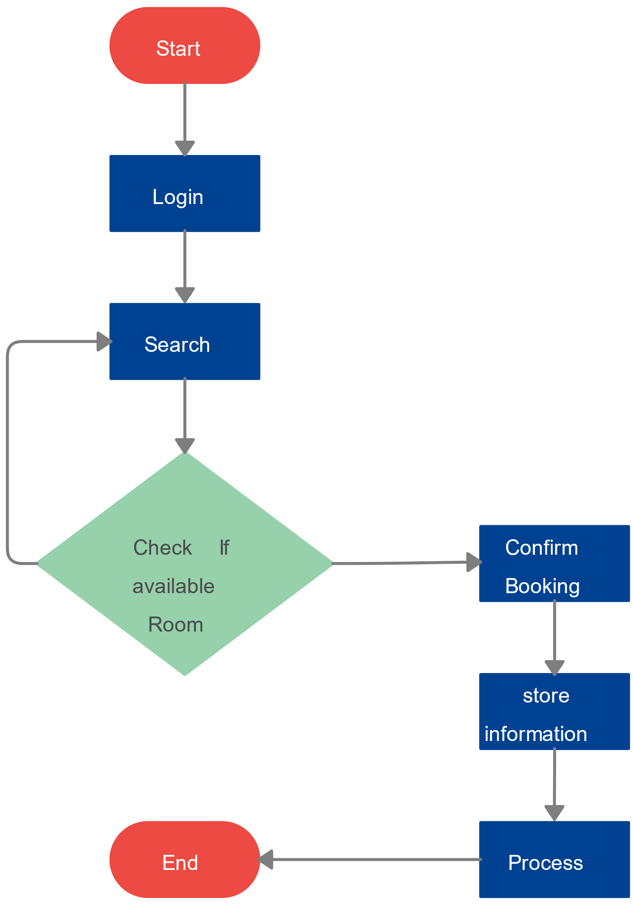
Block Diagram

Slide 15
DEVELOPMENT

Slide 16
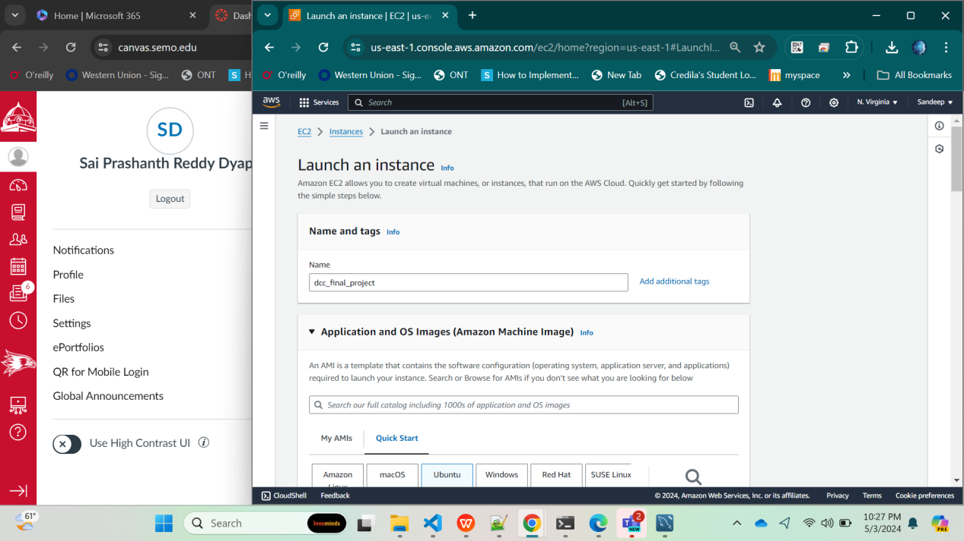

Slide 17
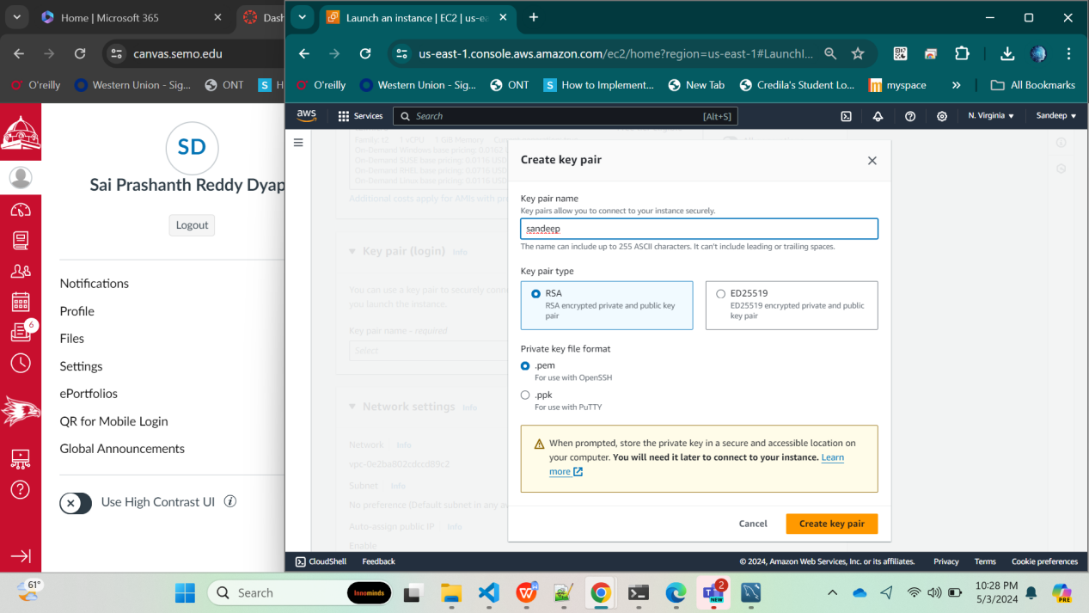

Slide 18
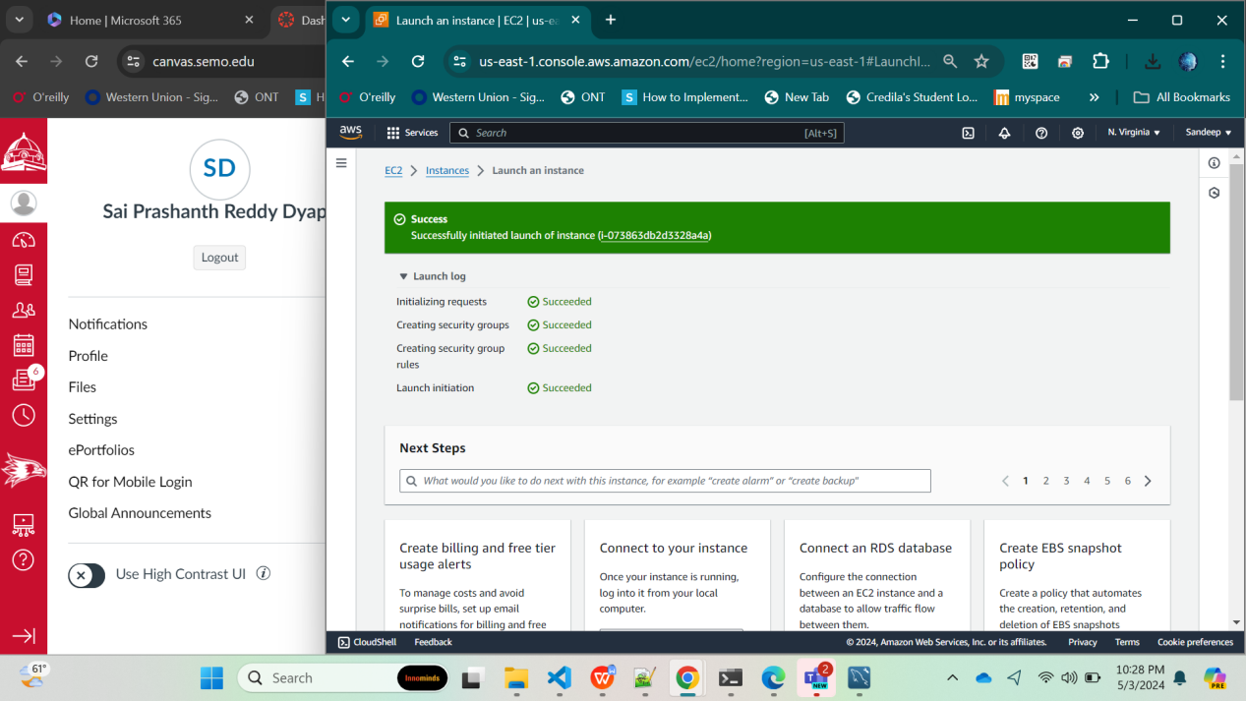

Slide 19
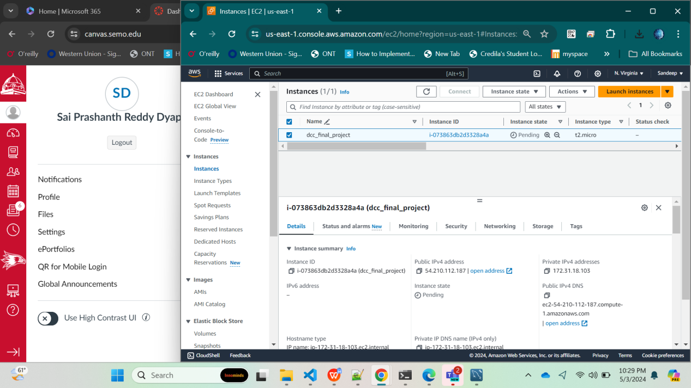

Slide 20
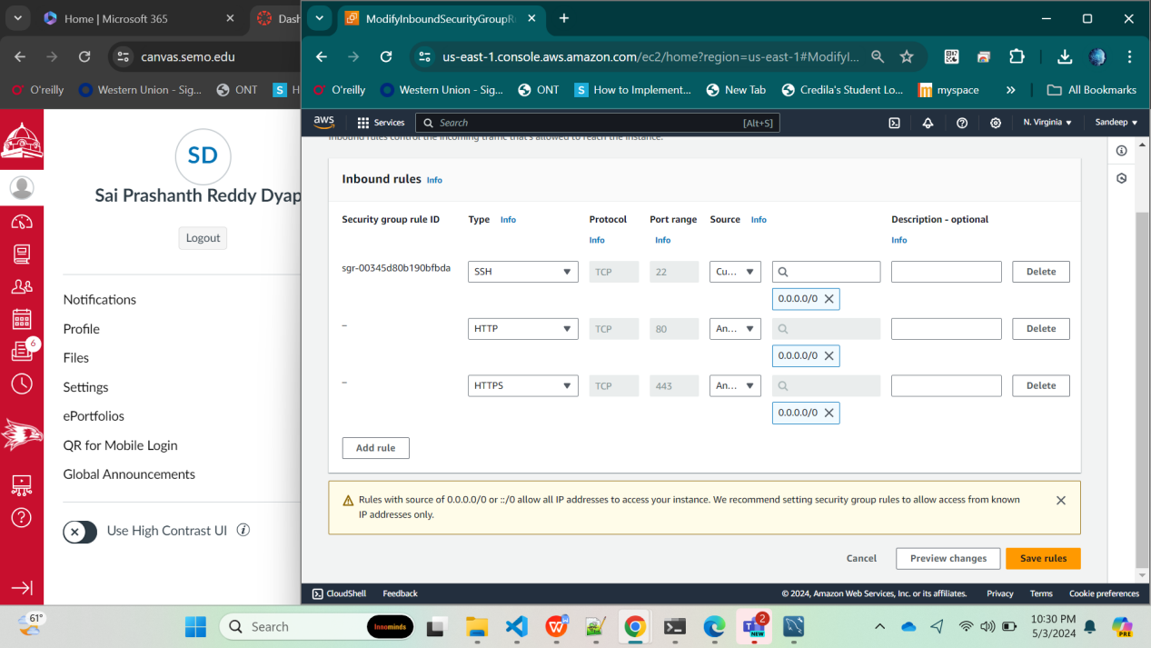

Slide 21
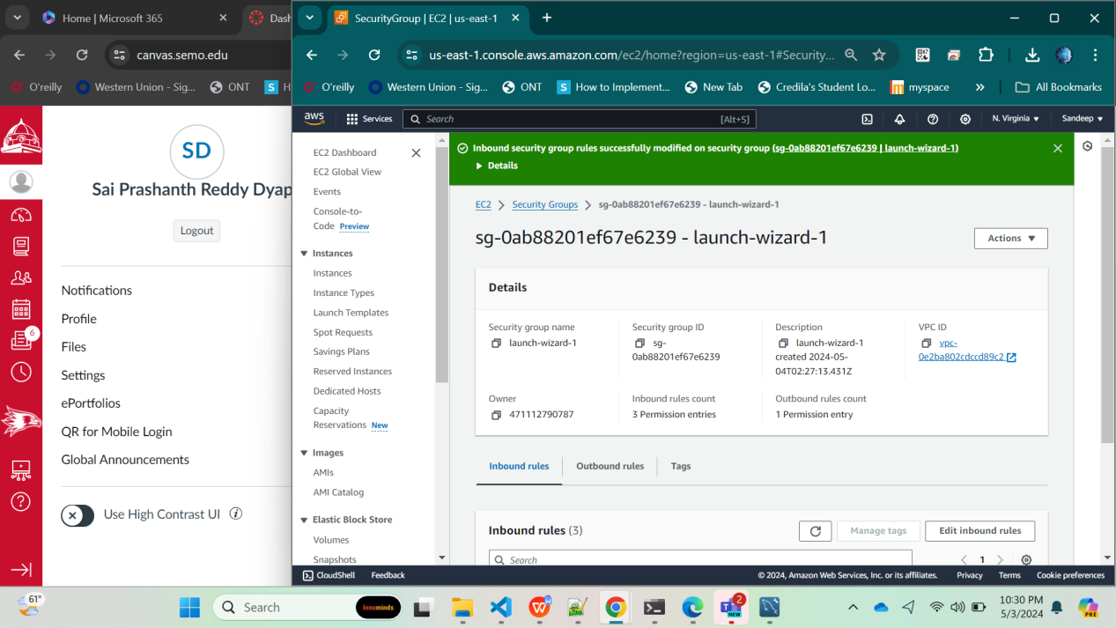

Slide 22
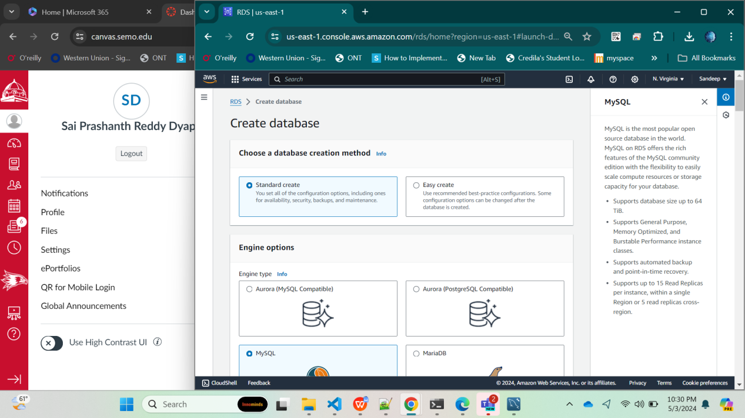

Slide 23
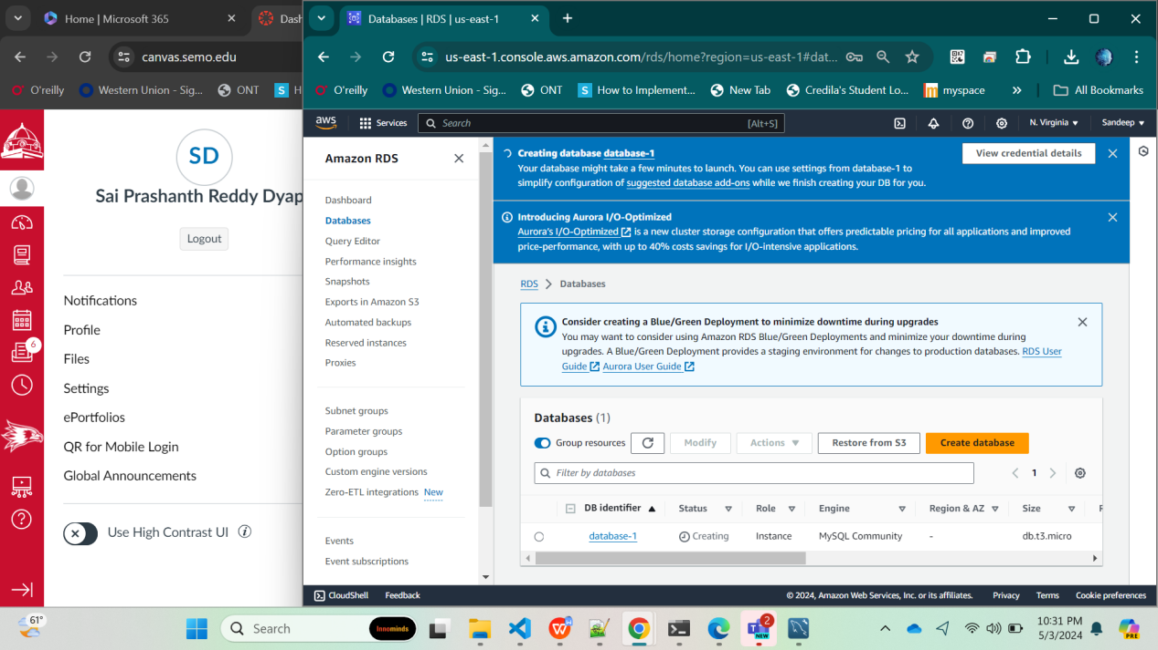

Slide 24
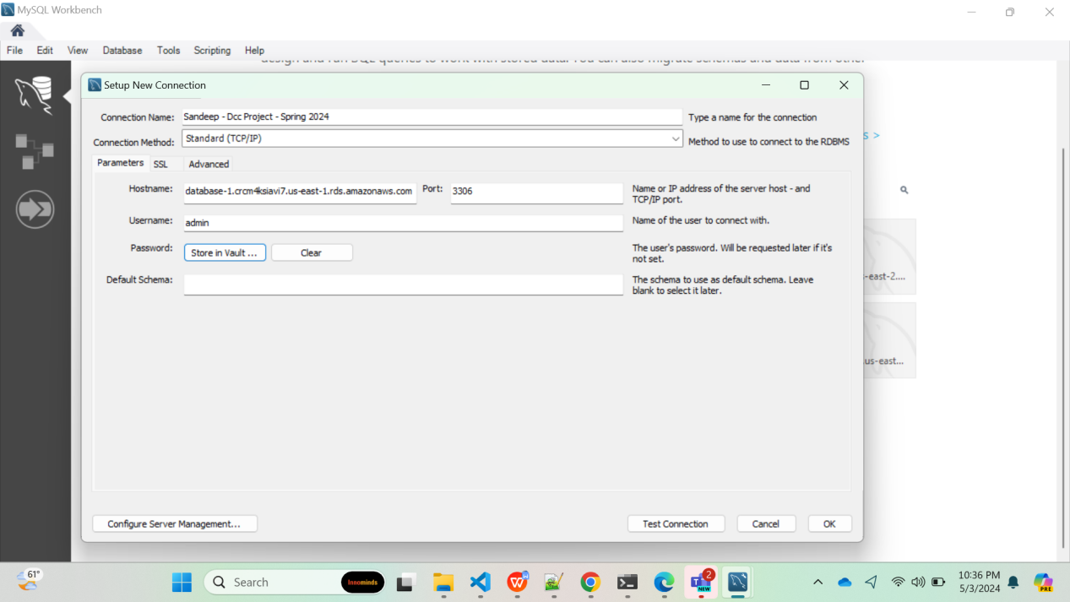

Slide 26
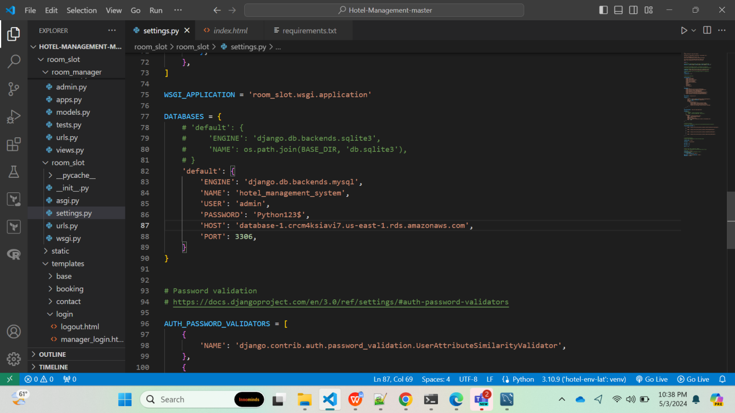

Slide 27
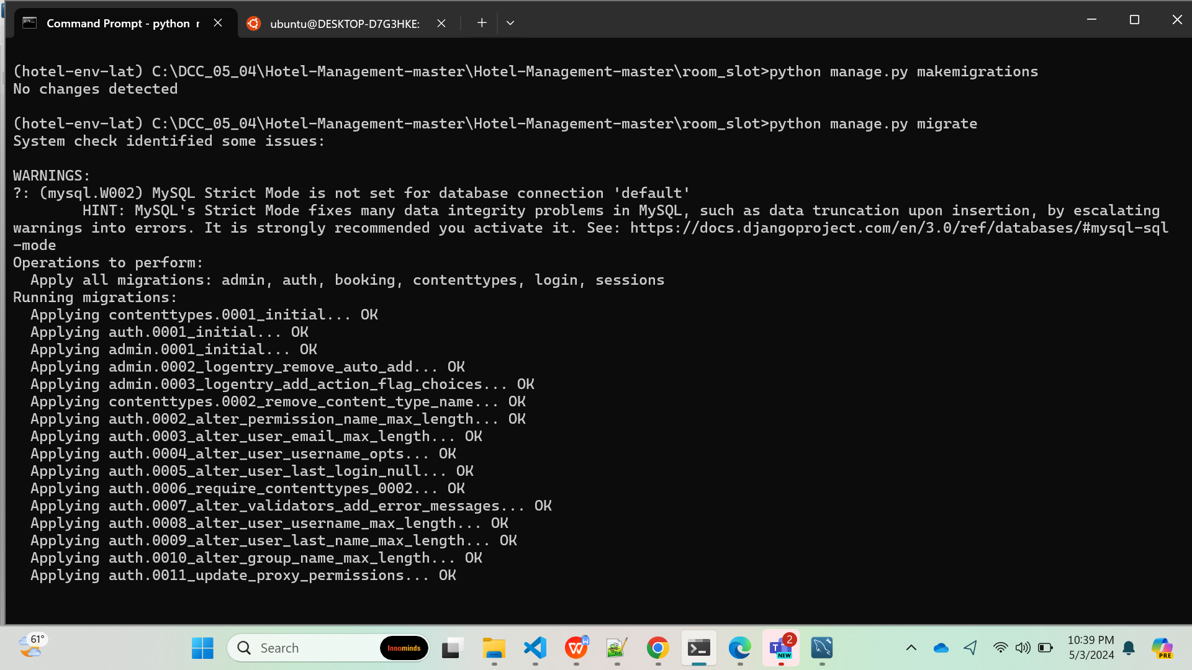

Slide 28
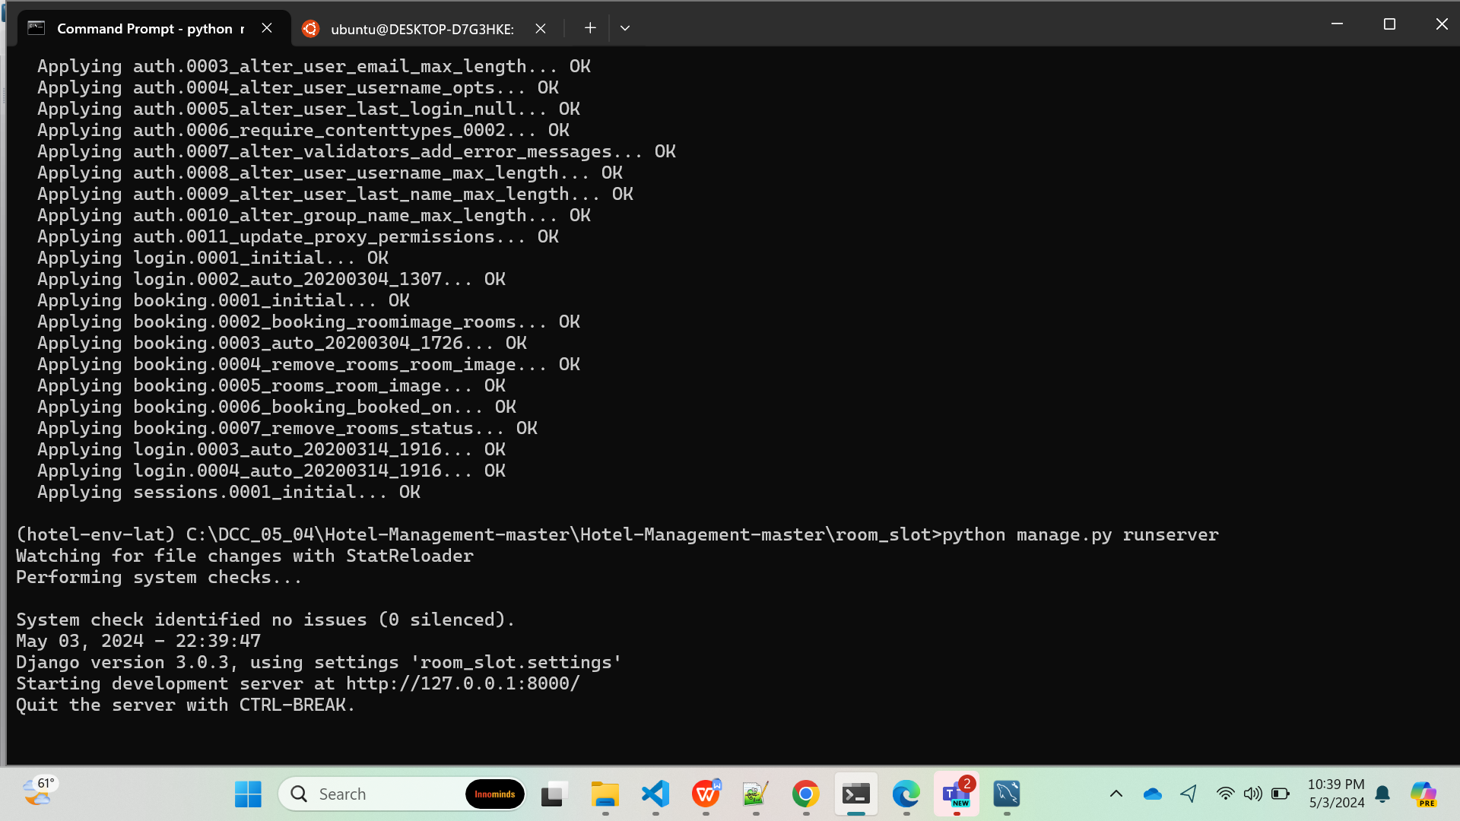

Slide 29
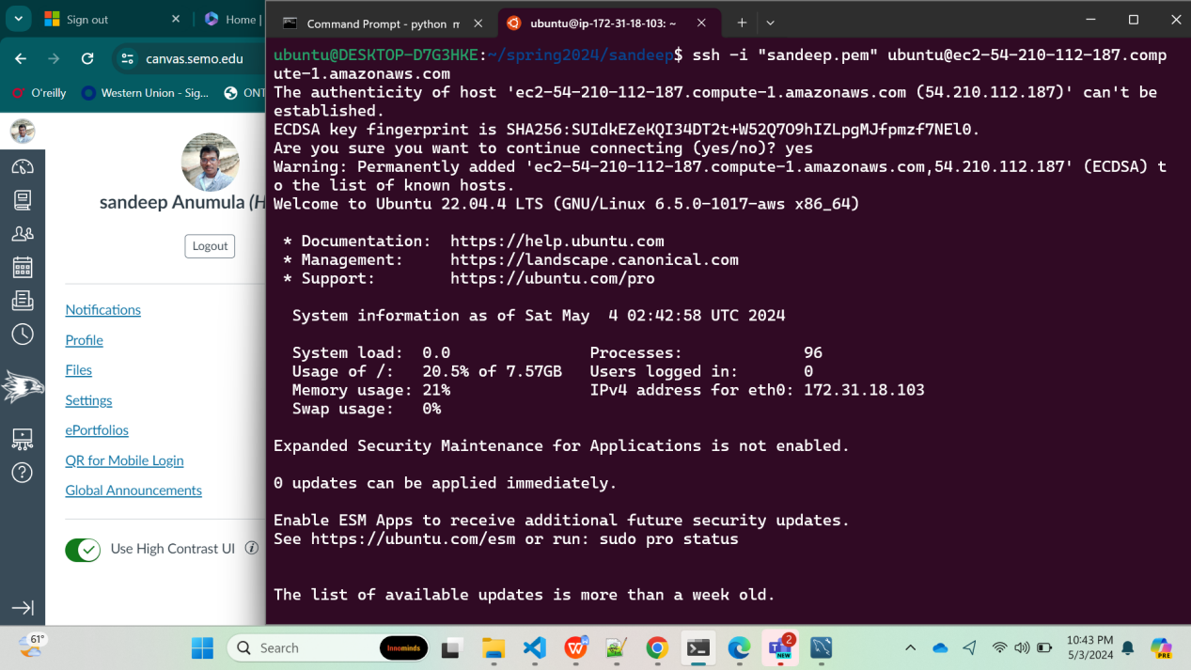

Slide 30
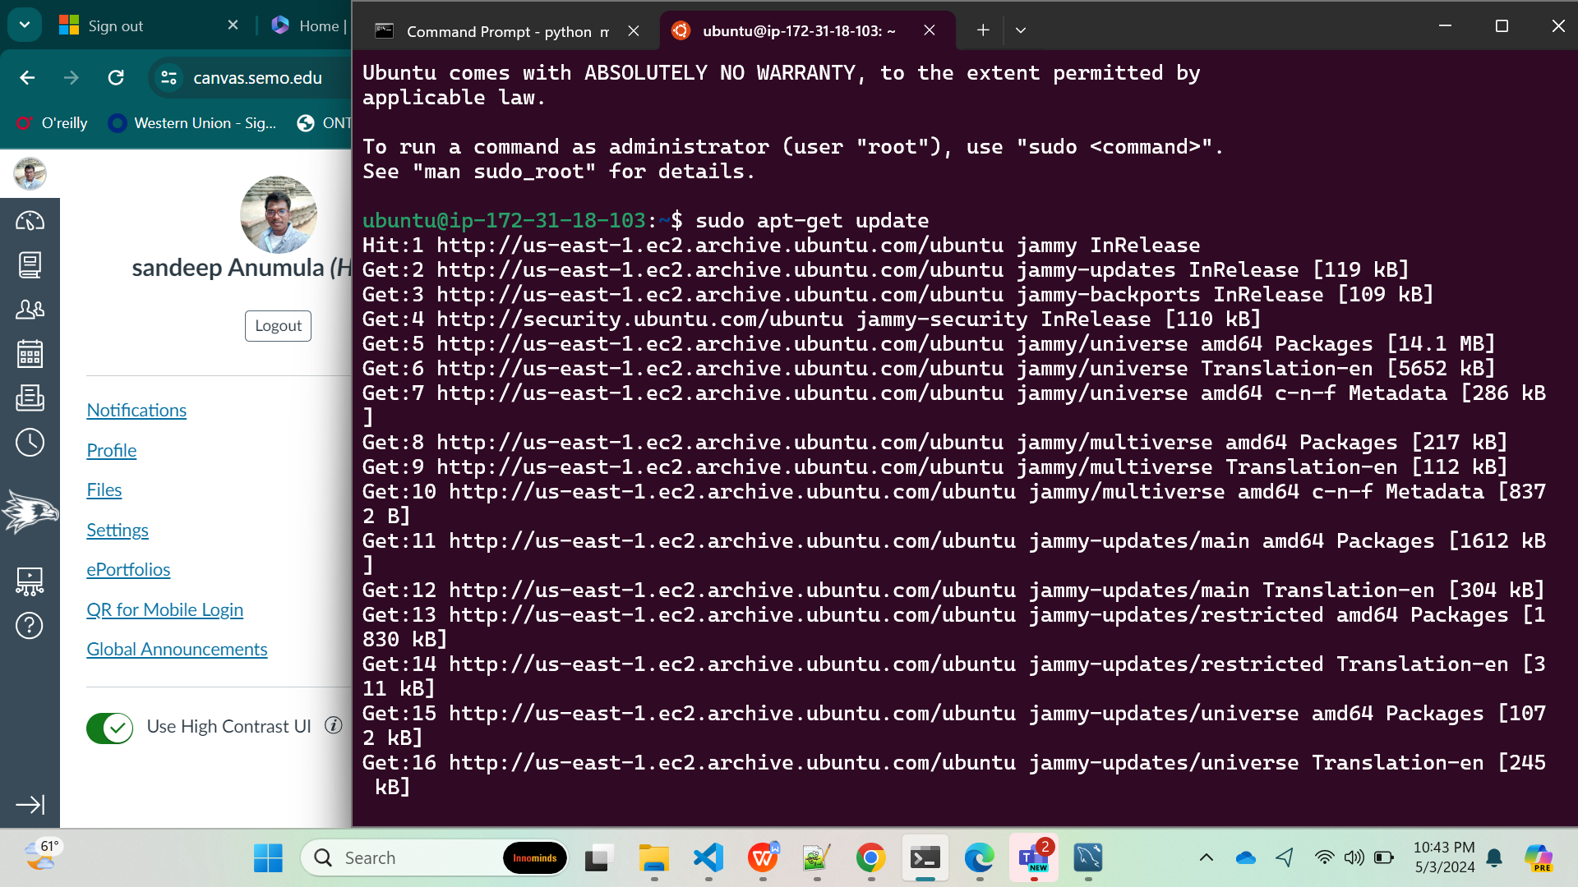

Slide 31
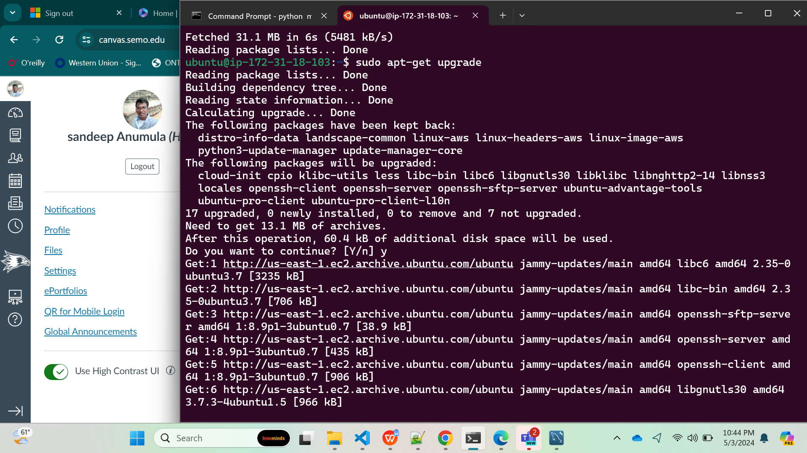

Slide 32
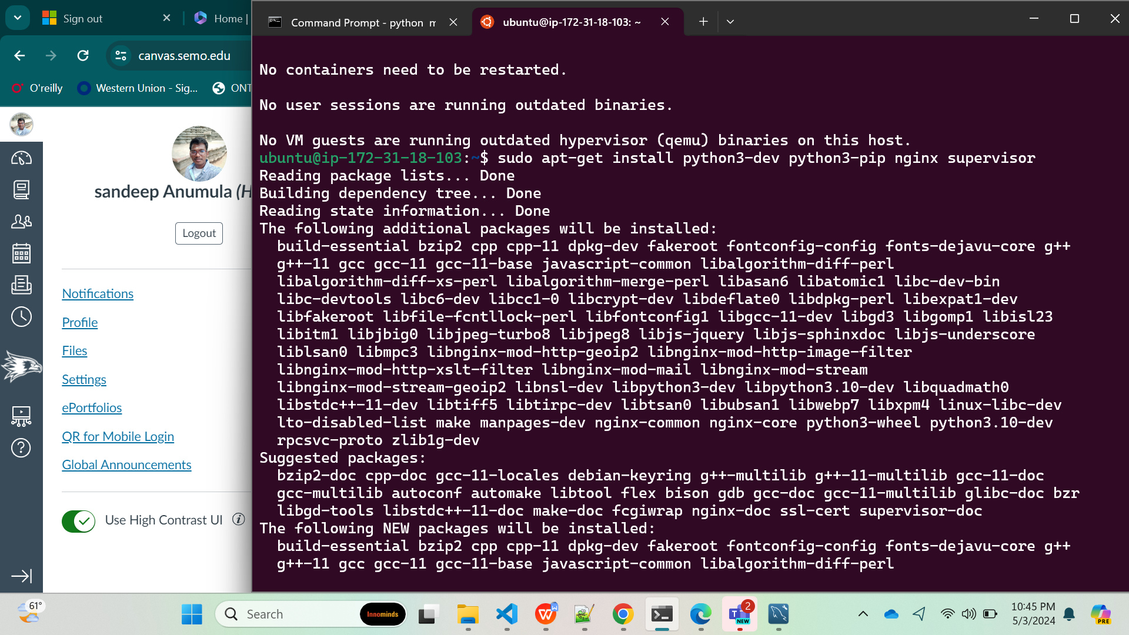

Slide 33
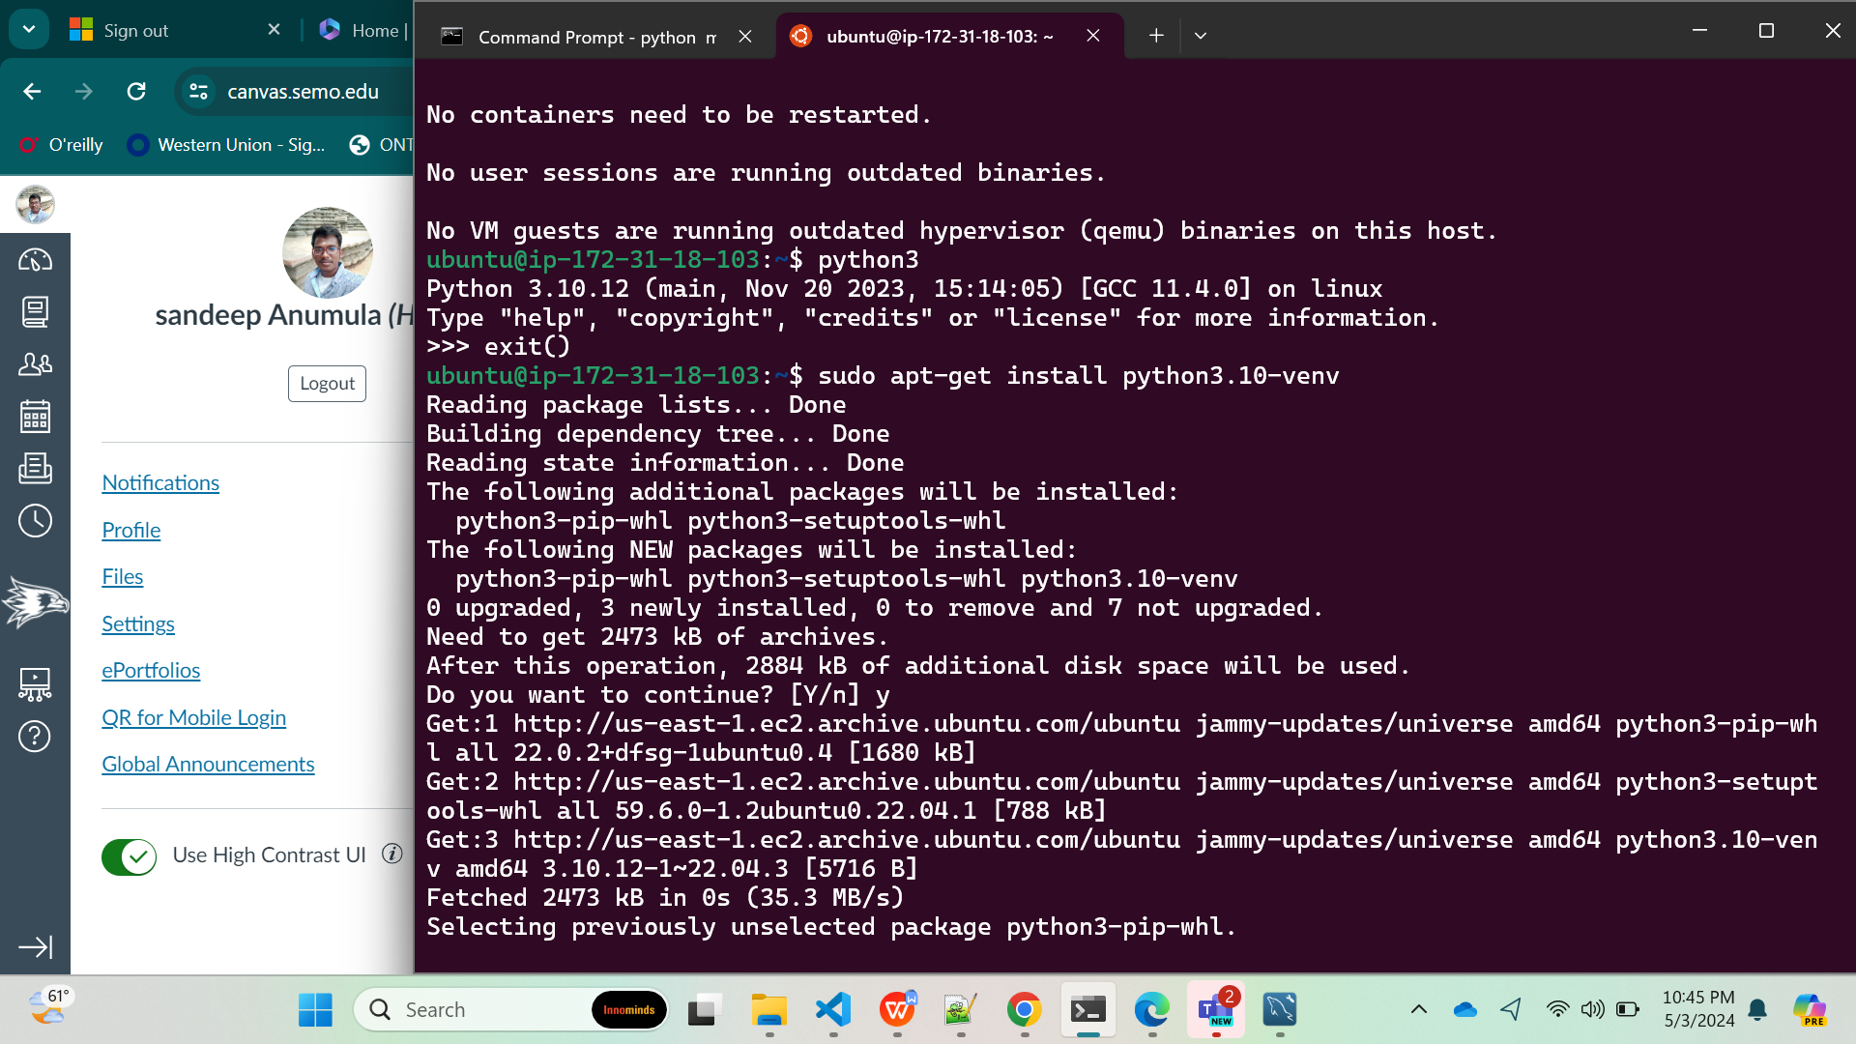

Slide 34
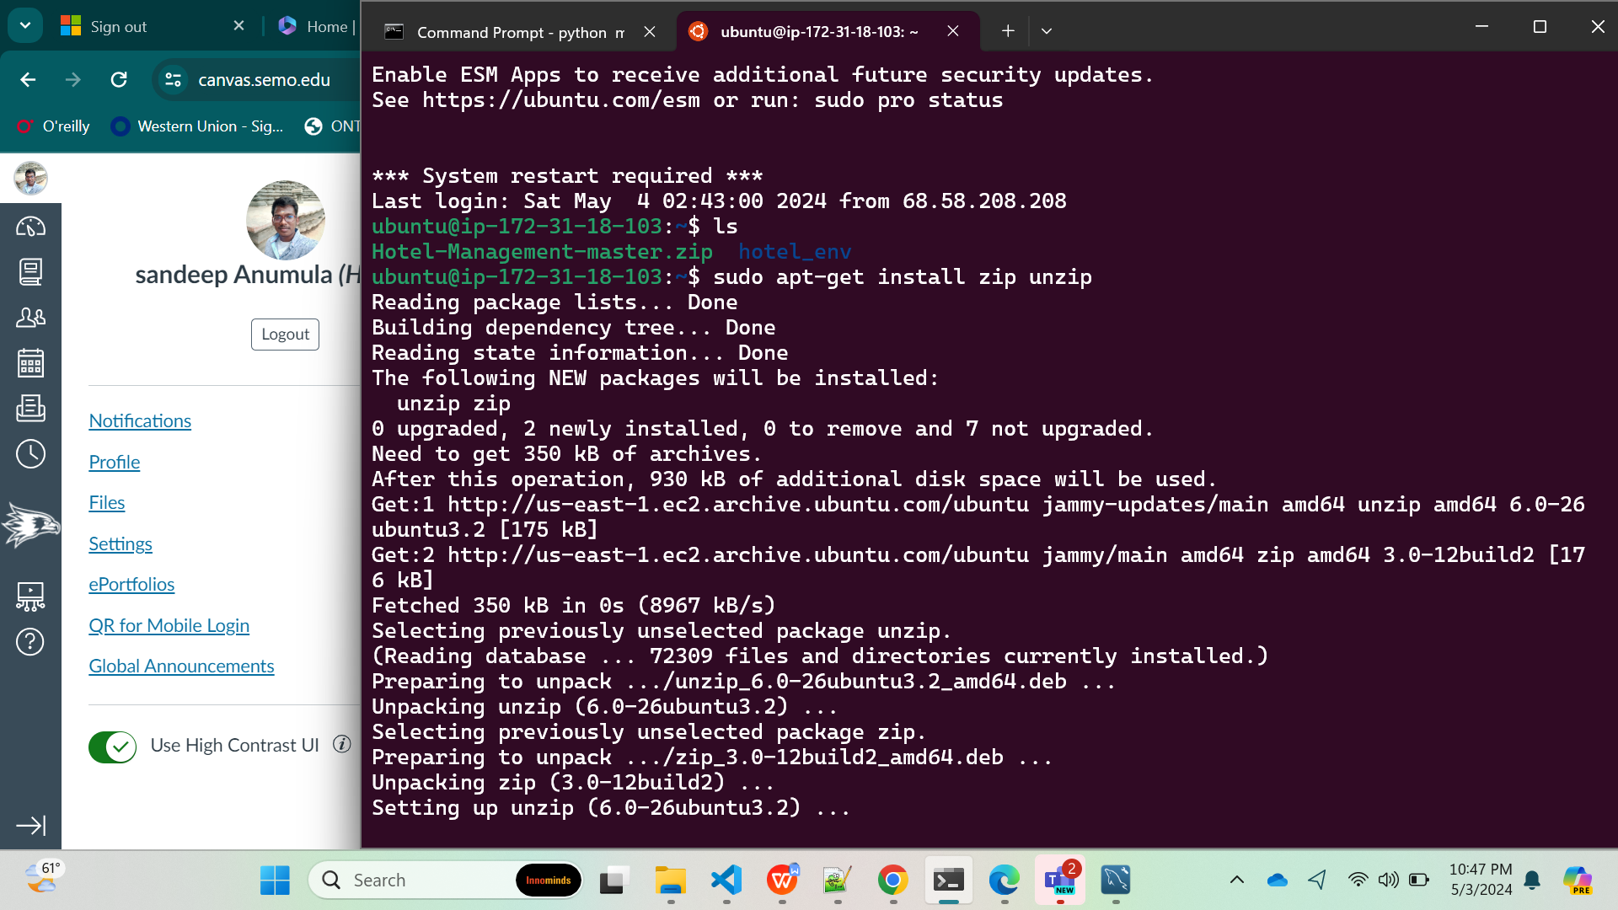

Slide 35
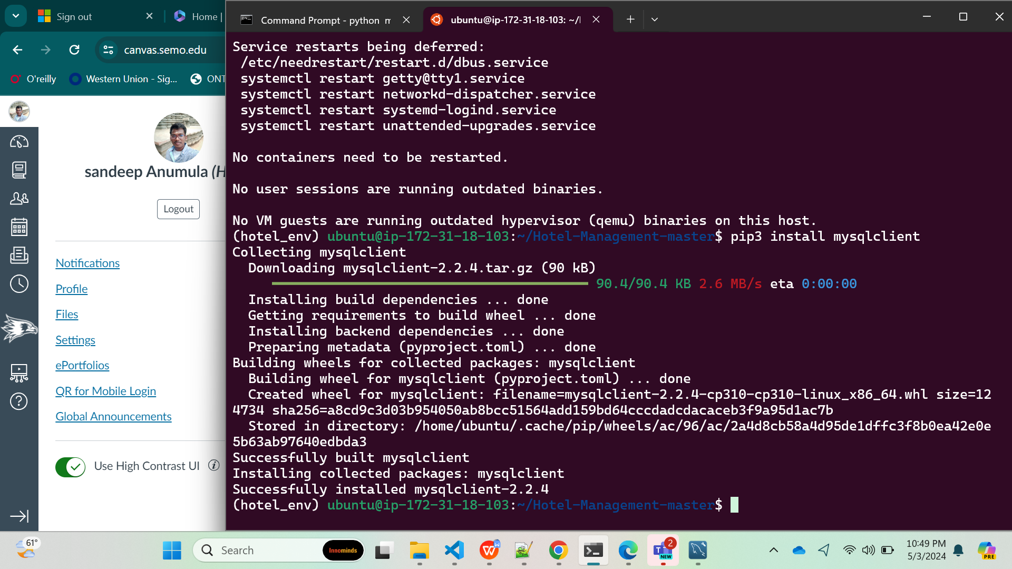

Slide 36
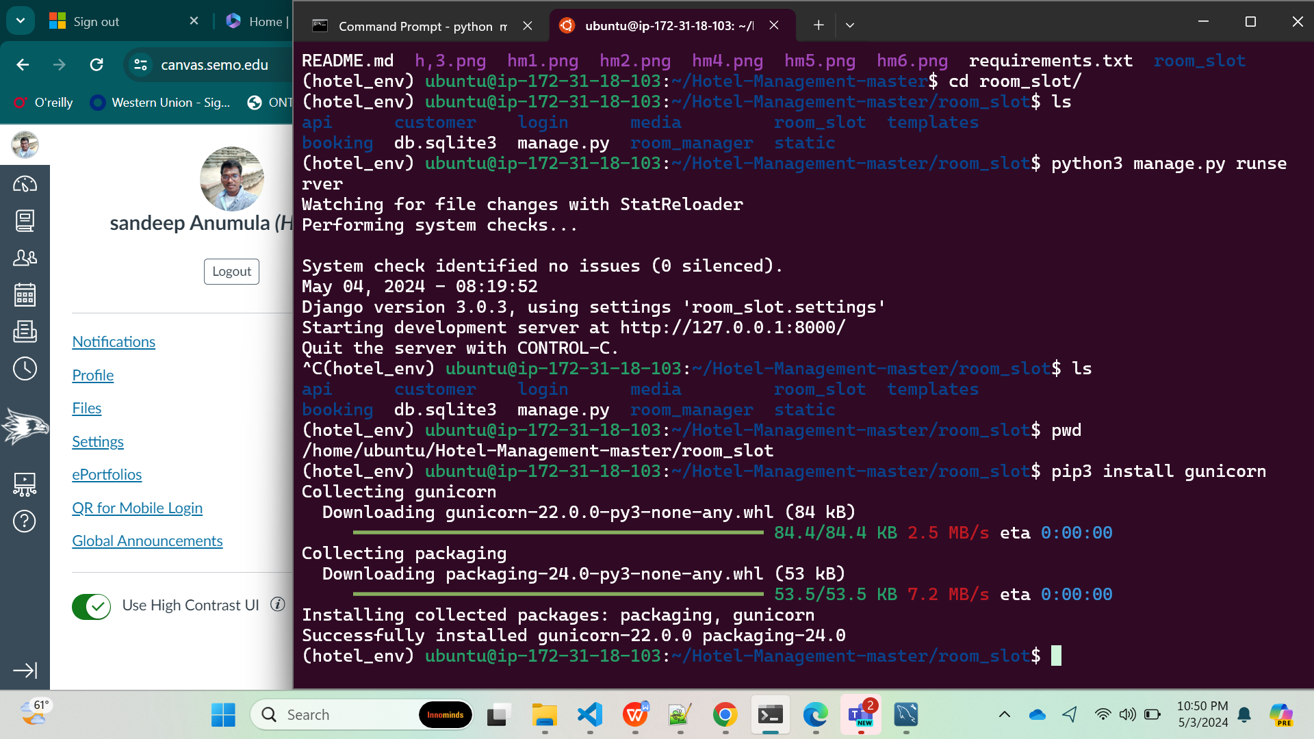

Slide 37
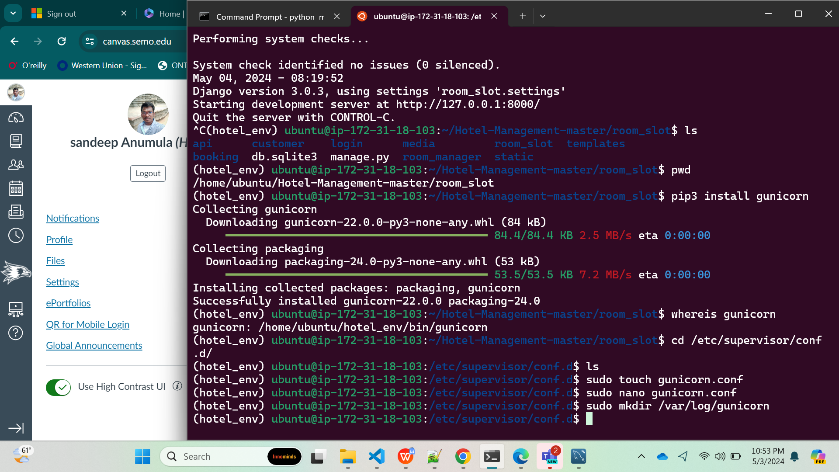

Slide 39
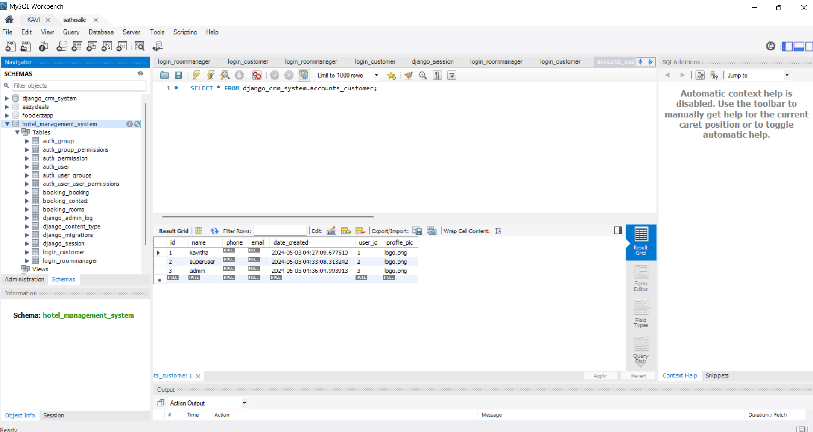

Slide 40
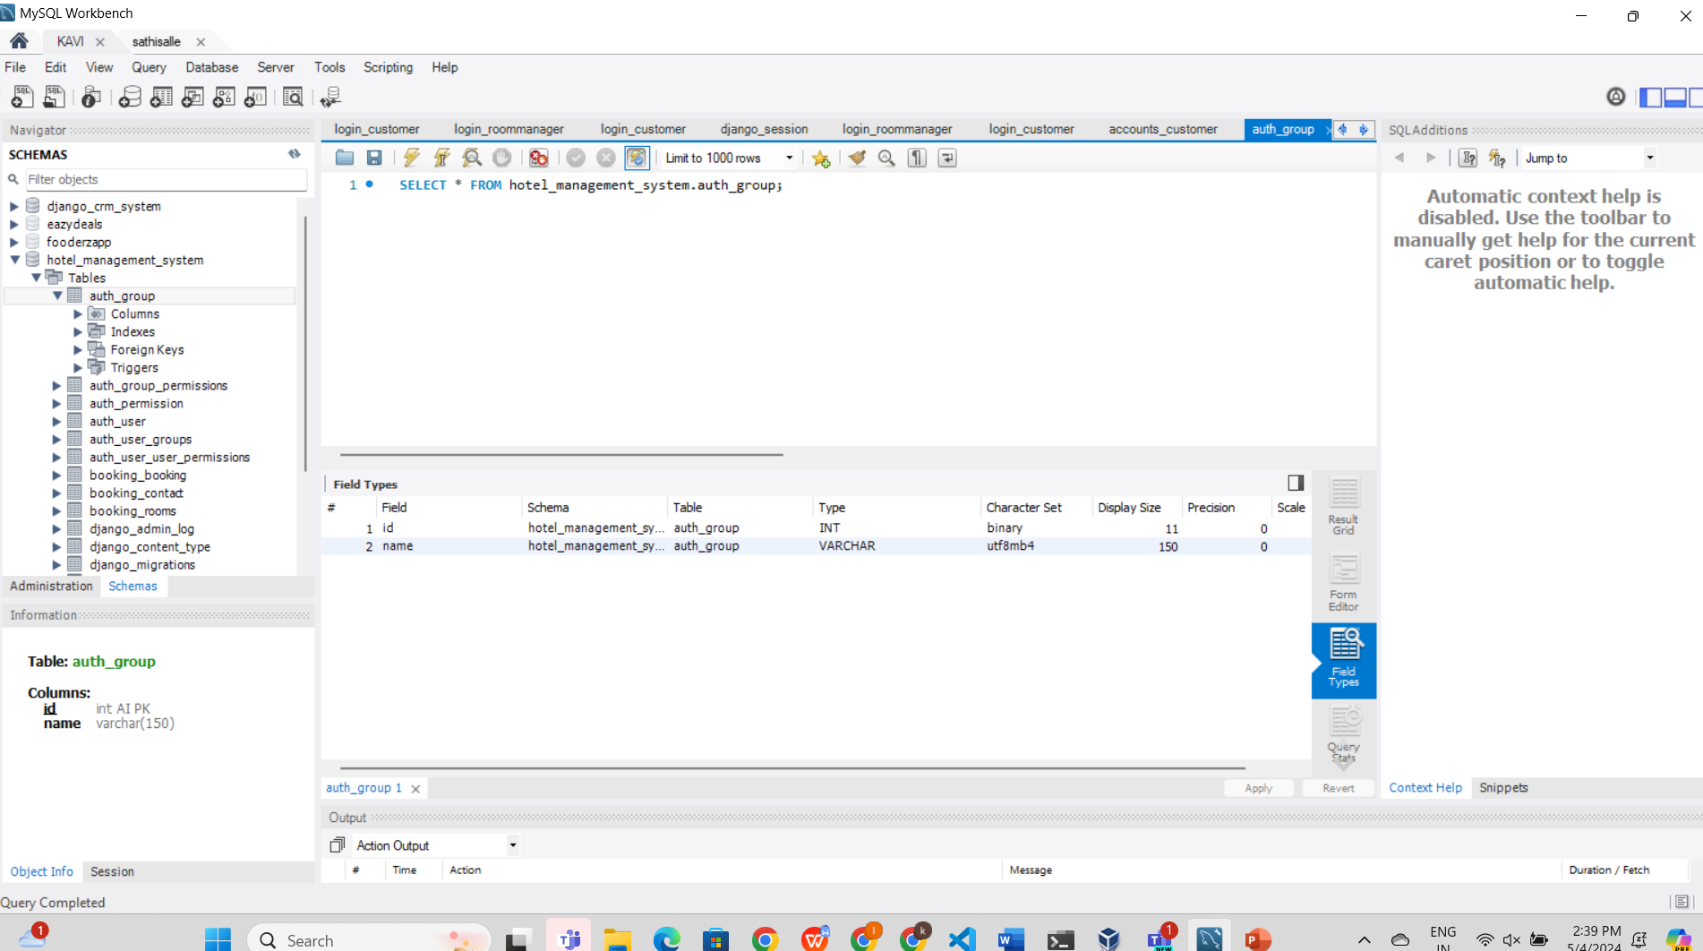

Slide 41
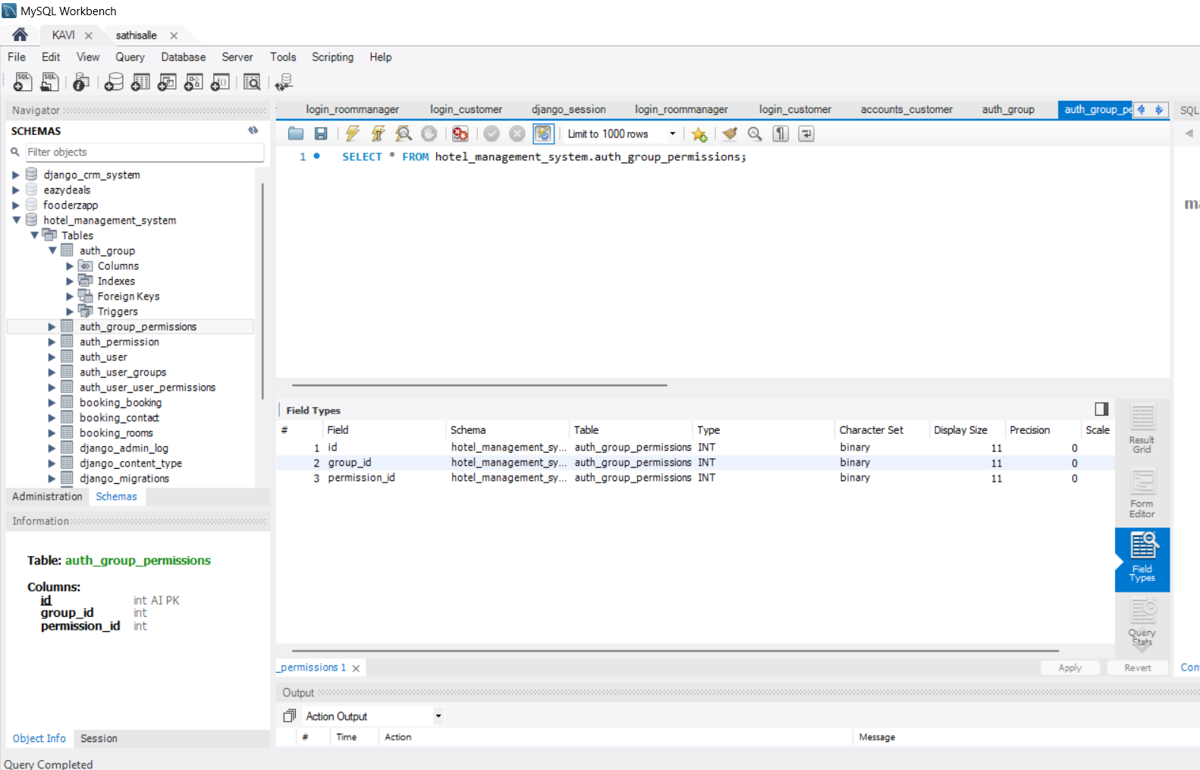

Slide 42
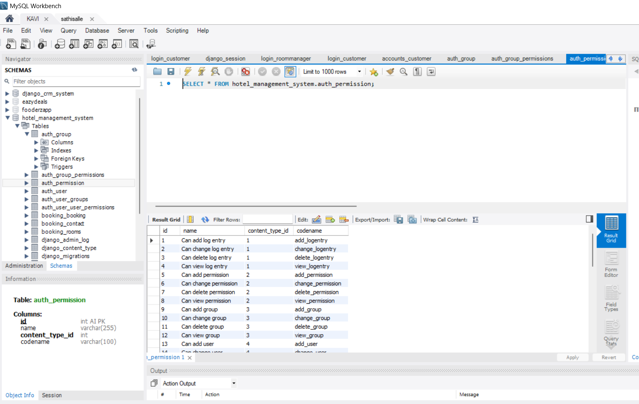

Slide 43
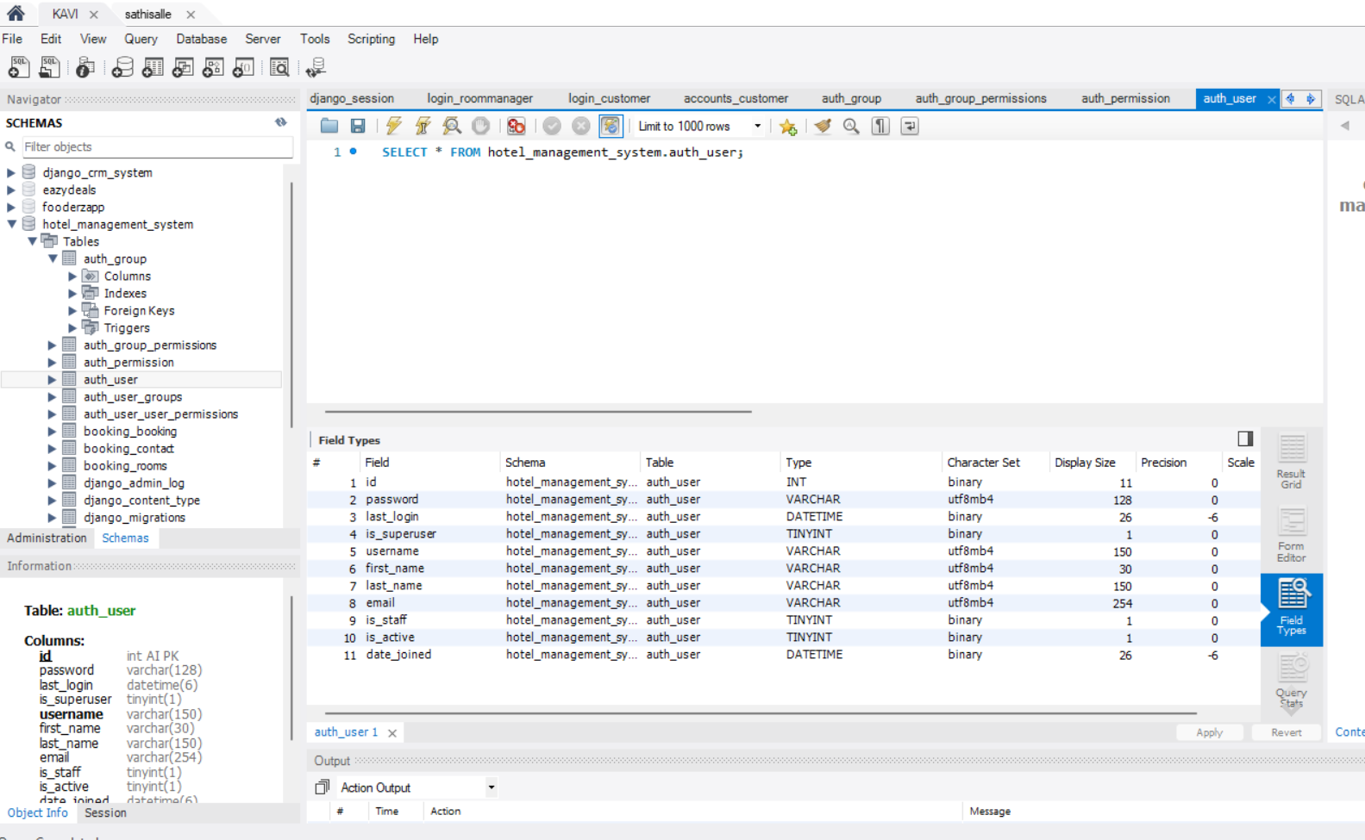

Slide 44
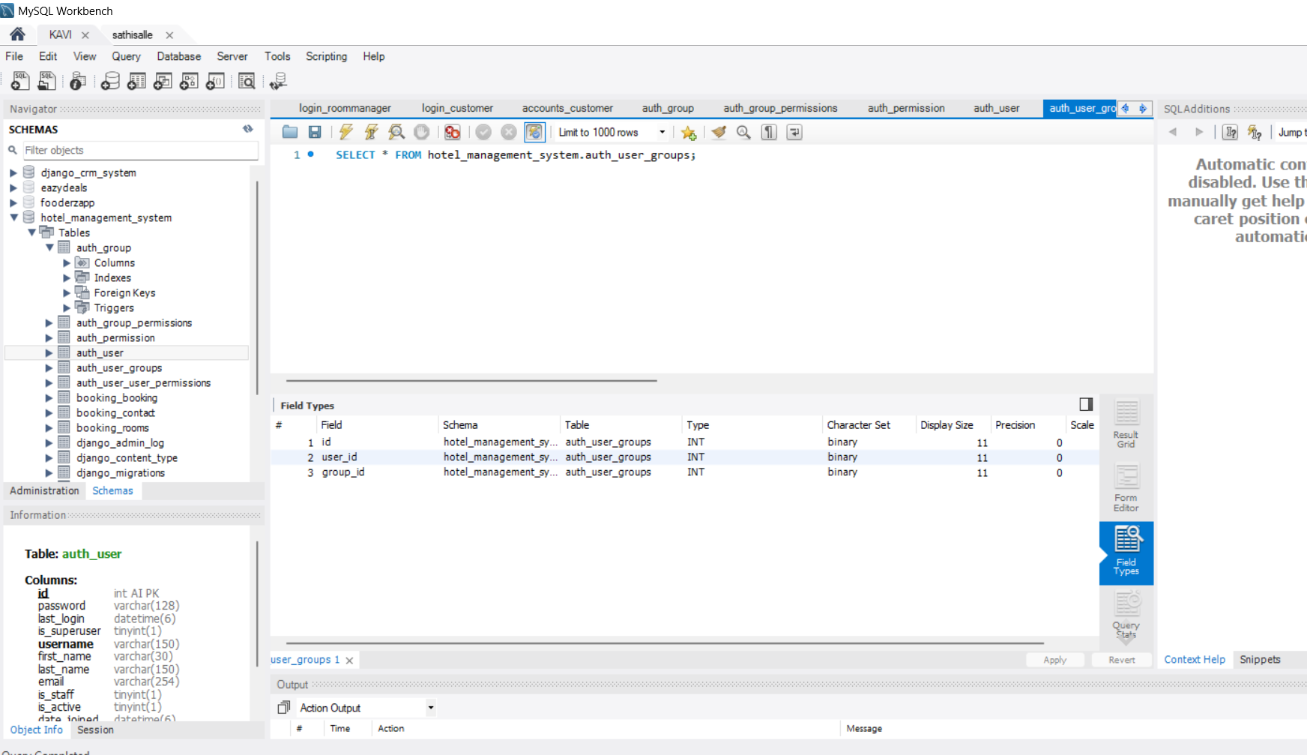

Slide 45
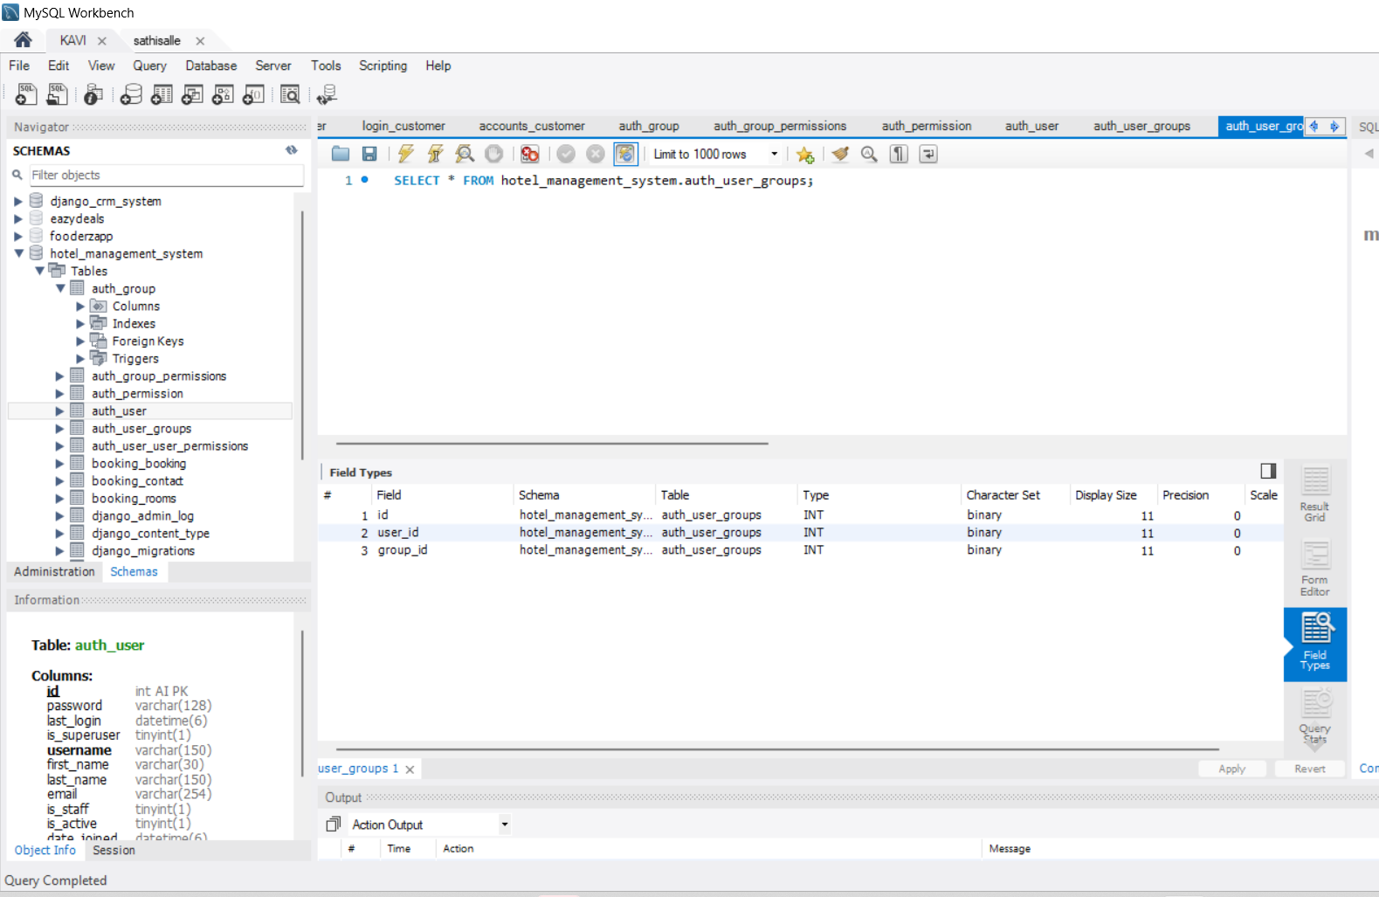

Slide 46
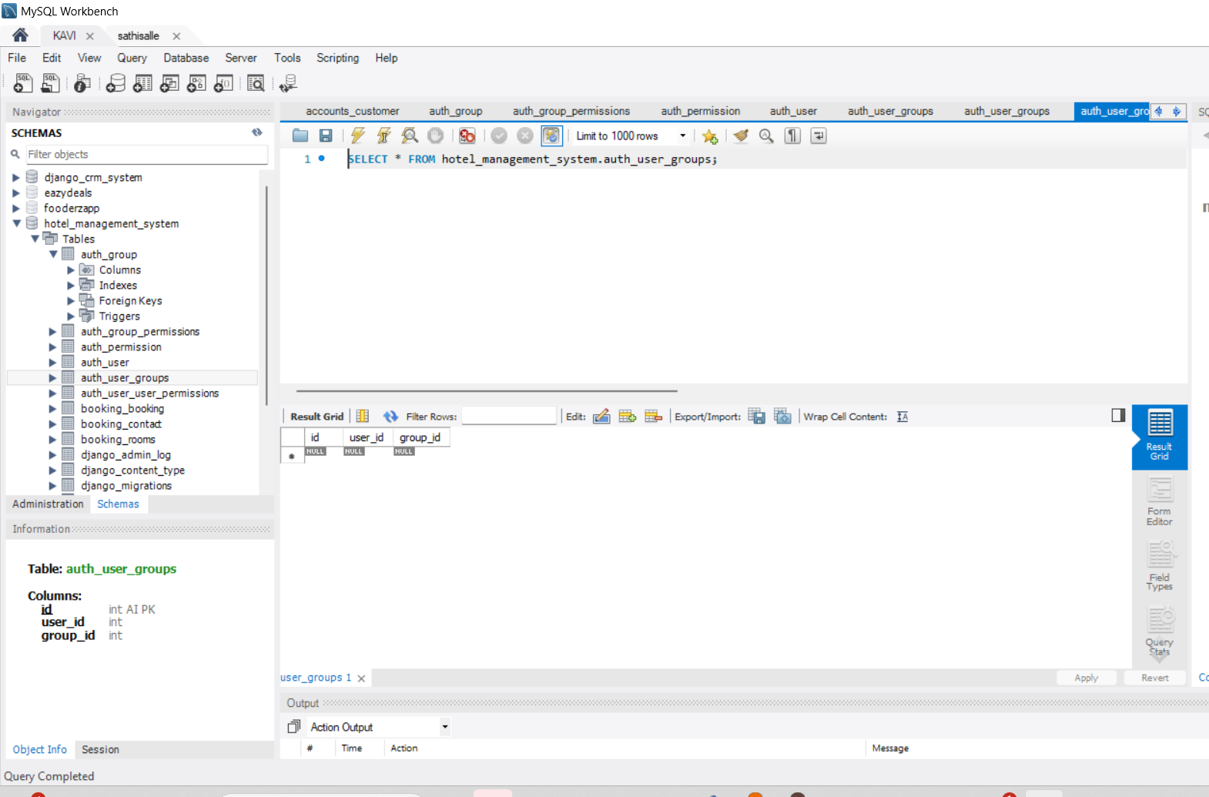

Slide 47


Slide 48
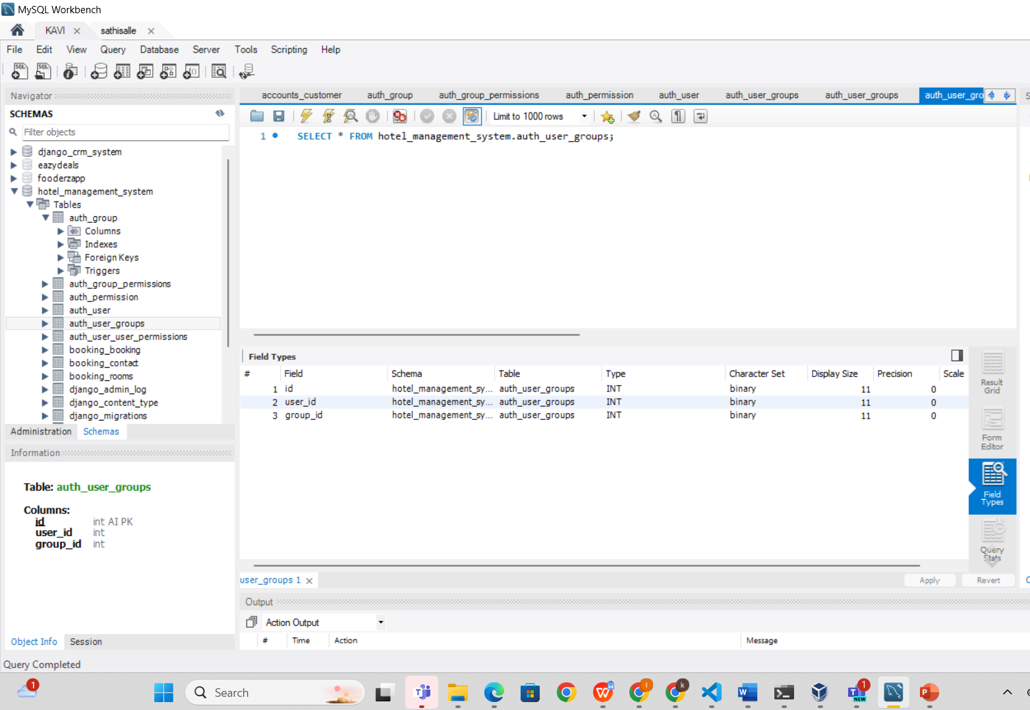

Slide 49
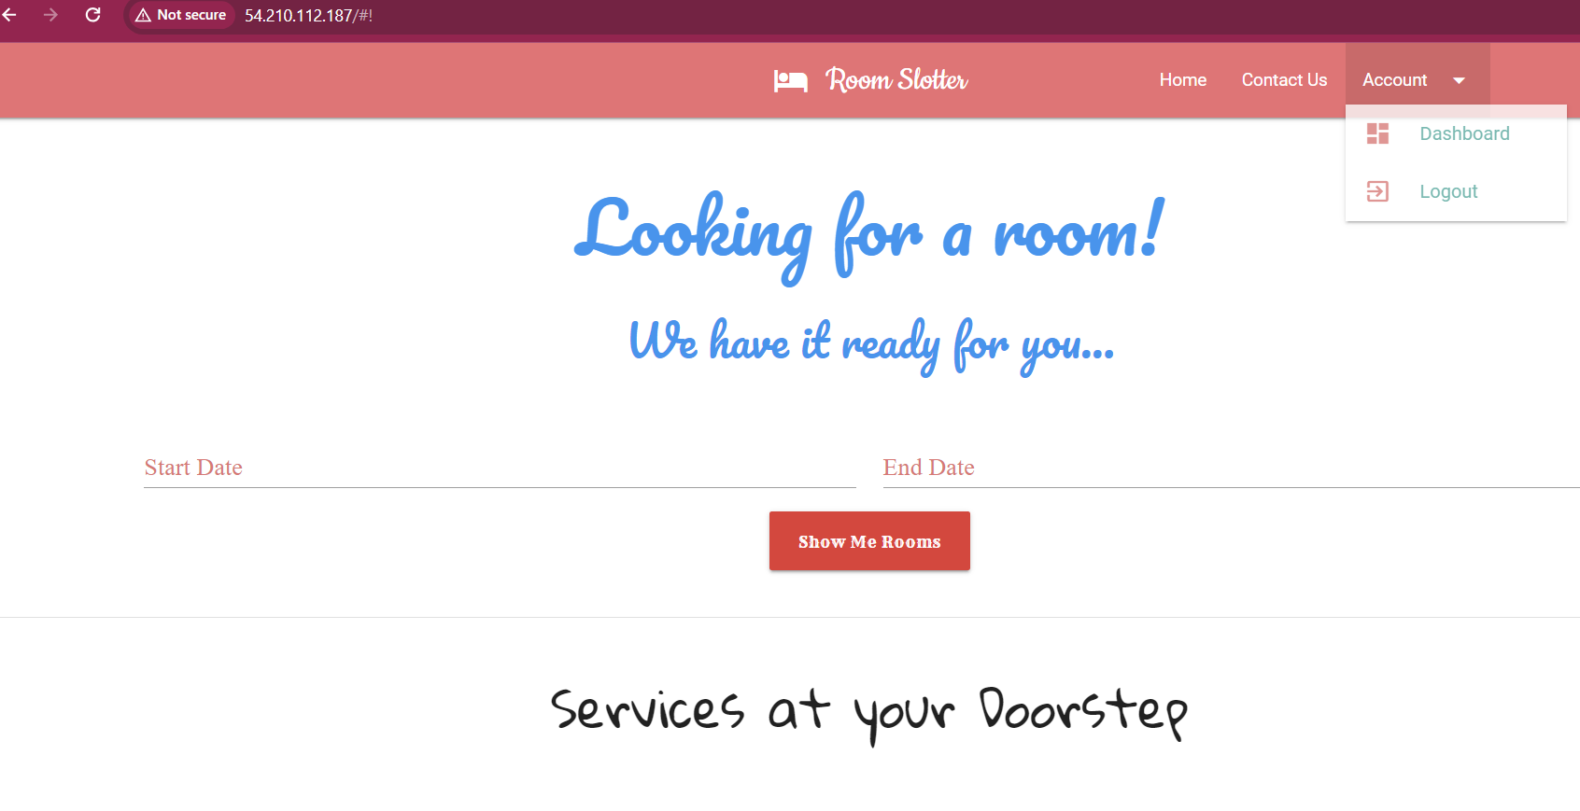

Slide 50
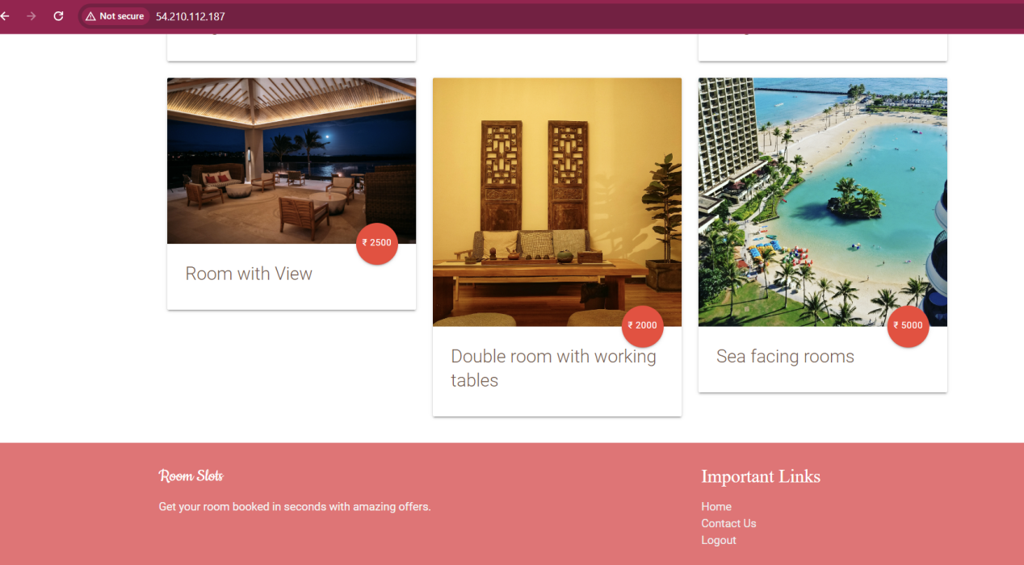

Slide 51
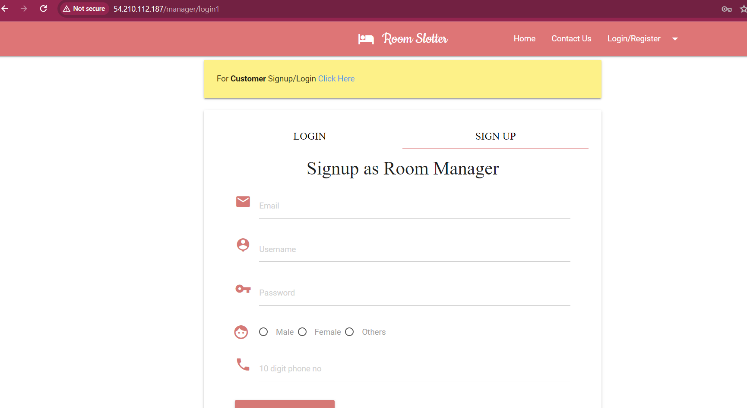

Slide 52
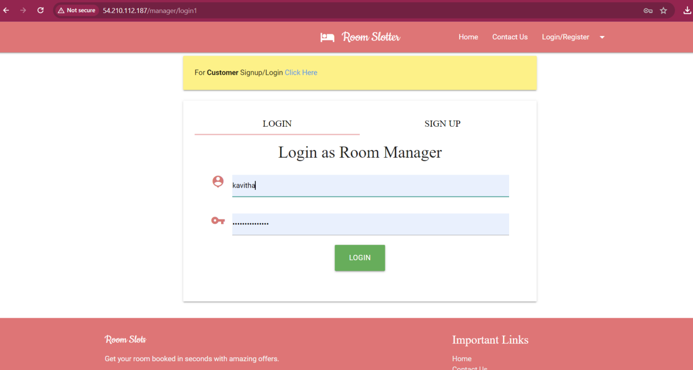

Slide 54
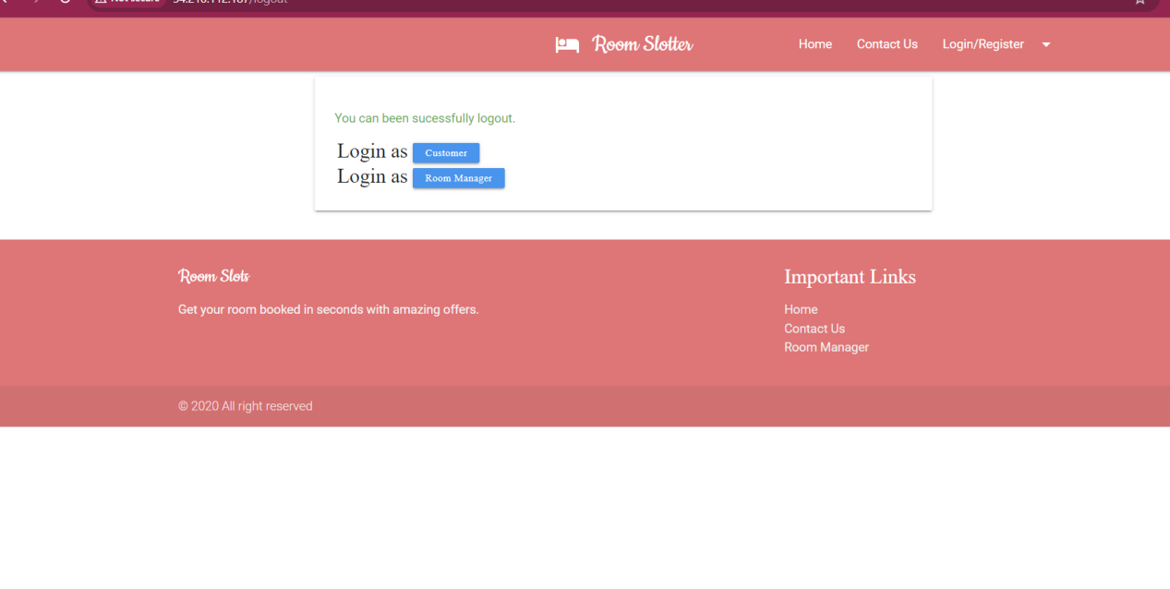

Slide 55
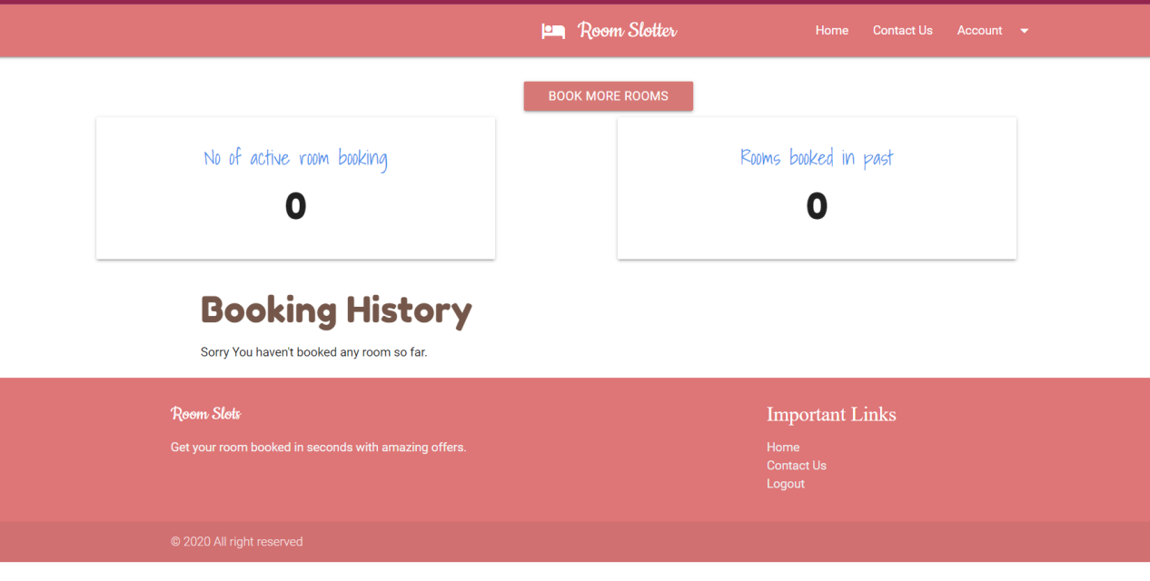

Slide 56
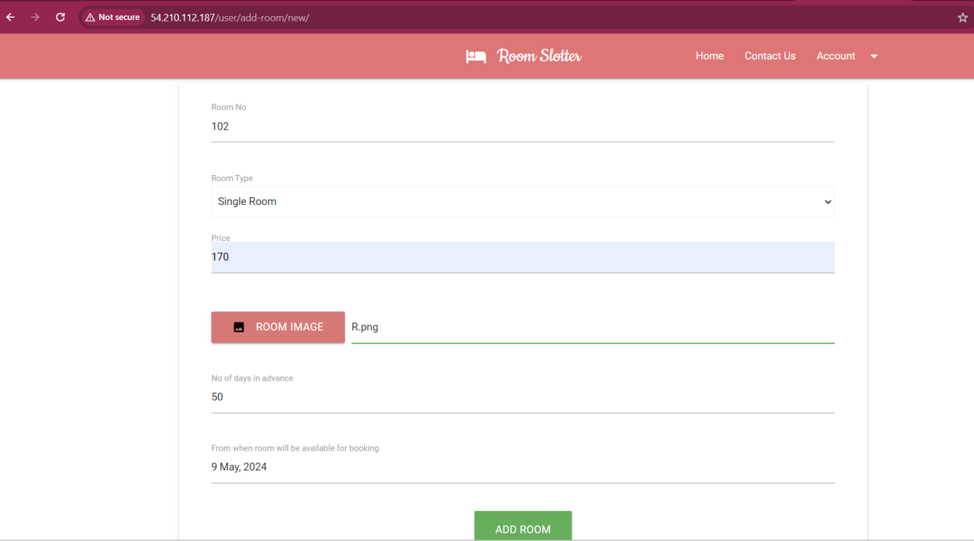

Slide 57
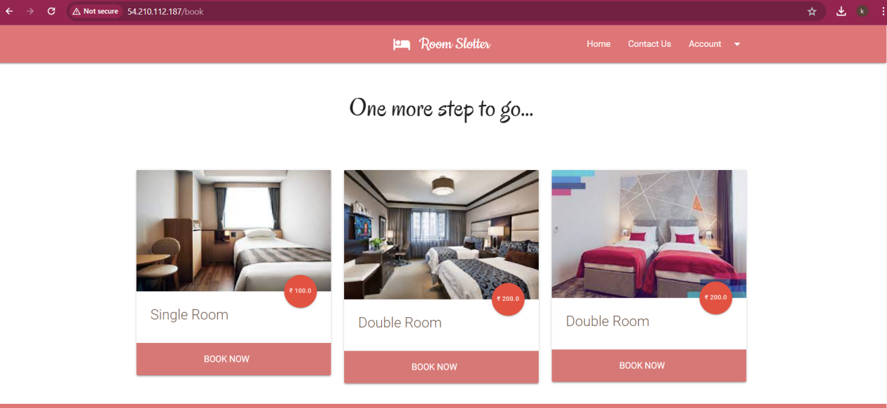

Slide 58
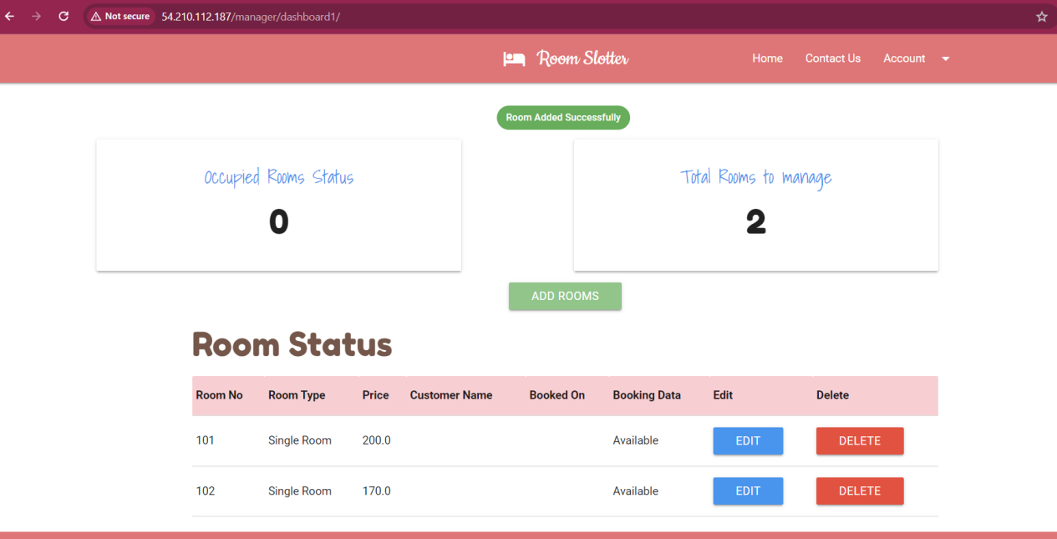

Slide 59
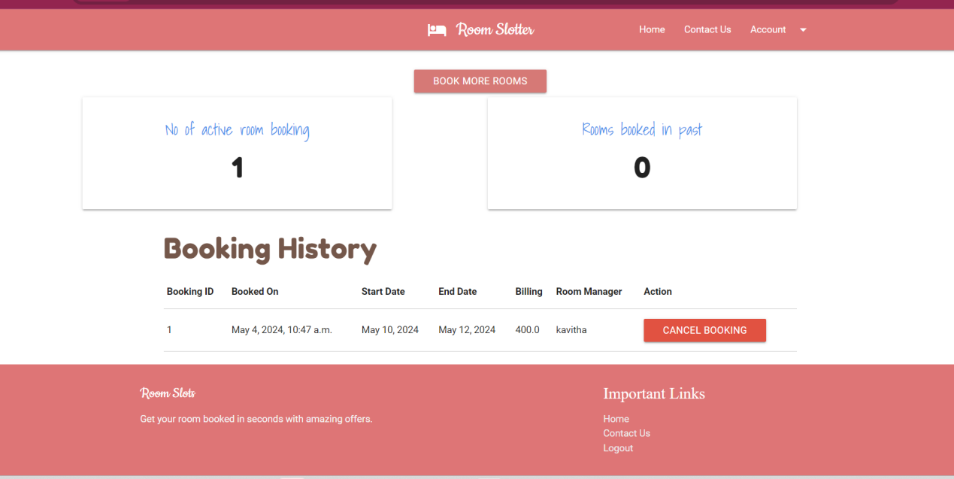

Slide 60
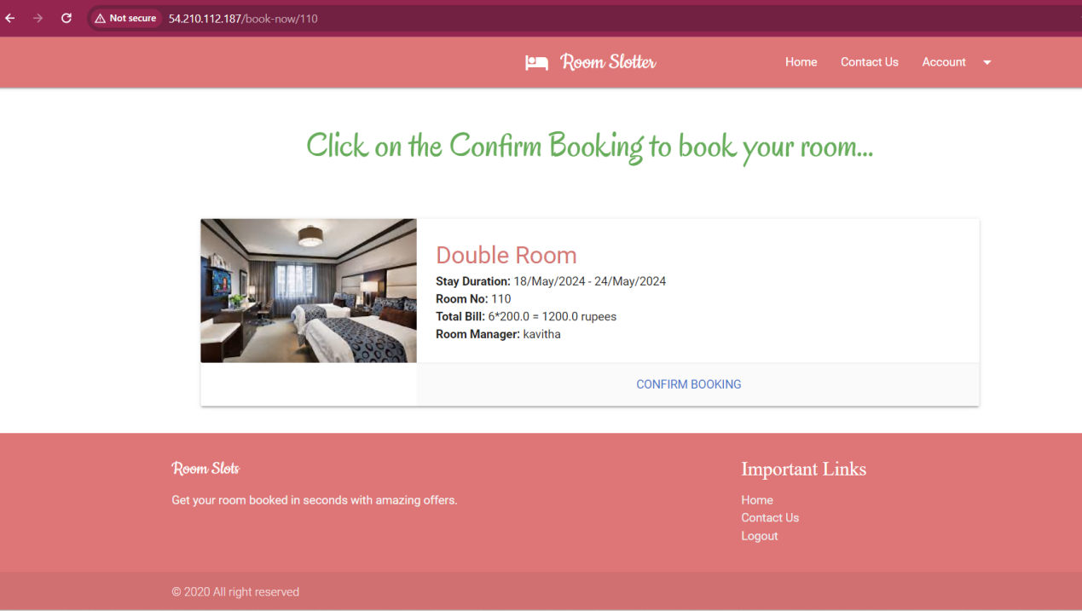

Slide 61
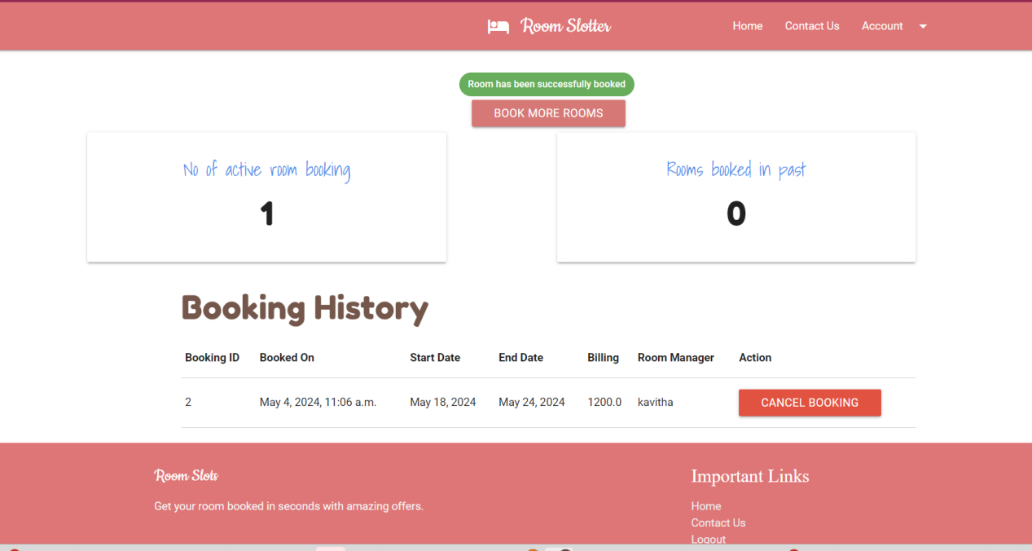

Slide 62
Implementation
Initial Planning: Begin by defining the architecture, design, and layout of the hotel management system, outlining essential features such as room reservations, guest check-ins, billing, and reporting.
Requirements Gathering: Identify the specific needs and requirements of the hotel, including the number of rooms, types of accommodations, amenities, and guest preferences.
Platform Selection: Choose a suitable hotel management software platform based on factors like budget, scalability, ease of use, and compatibility with existing systems.
System Configuration: Configure the selected hotel management software to align with the hotel's operational workflows, including room categorization, pricing structures, and user permissions.

Slide 63
Implementation
User Interface Design: Develop a user-friendly interface for the hotel management system, ensuring intuitive navigation and accessibility for hotel staff across various departments.
Feature Development: Implement core features such as room booking, guest check-in/check-out, housekeeping management, inventory tracking, and reporting functionality.
Integration with Third-party Systems: Integrate the hotel management system with external systems such as payment gateways, accounting software, property management systems (PMS), and online booking platforms.

Slide 64
Impl
Testing and Quality Assurance: Conduct thorough testing of the hotel management system to identify and rectify any bugs, errors, or usability issues before deployment.
Data Migration: Transfer existing hotel data, including guest profiles, reservations, and financial records, to the new management system, ensuring data integrity and accuracy.
Staff Training: Provide comprehensive training to hotel staff on how to use the new management system effectively, including system navigation, data entry, and troubleshooting procedures.

Slide 65
Impl
Deployment: Deploy the hotel management system across all relevant departments, ensuring seamless integration with existing hotel operations and minimal disruption to guest services.
Monitoring and Support: Implement monitoring tools to track system performance and user feedback, providing ongoing support and maintenance to address any issues that arise.
Security Measures: Implement robust security measures to protect sensitive guest data, including encryption, access controls, and regular security audits.
Customization and Scalability: Customize the hotel management system to accommodate unique hotel requirements and ensure scalability to support future growth and expansion.
Compliance and Regulations: Ensure that the hotel management system complies with relevant industry regulations and standards, such as data protection laws and payment card industry (PCI) compliance.

Slide 66
Impl
Mobile Accessibility: Develop mobile-friendly interfaces or companion mobile apps to enable hotel staff to access the management system from anywhere, enhancing flexibility and productivity.
Guest Experience Enhancement: Implement features aimed at enhancing the guest experience, such as online booking portals, self-service kiosks, and personalized guest preferences management.
Analytics and Reporting: Incorporate analytics and reporting tools to track key performance indicators (KPIs), analyze guest behavior, and generate actionable insights for decision-making.

Slide 67
Impl
Continuous Improvement: Establish processes for ongoing system enhancement and optimization based on user feedback, technological advancements, and industry best practices.
Stakeholder Engagement: Maintain open communication channels with hotel management, staff, and technology partners to ensure alignment with business goals and address evolving needs and challenges.

Slide 68


Slide 69


Slide 70
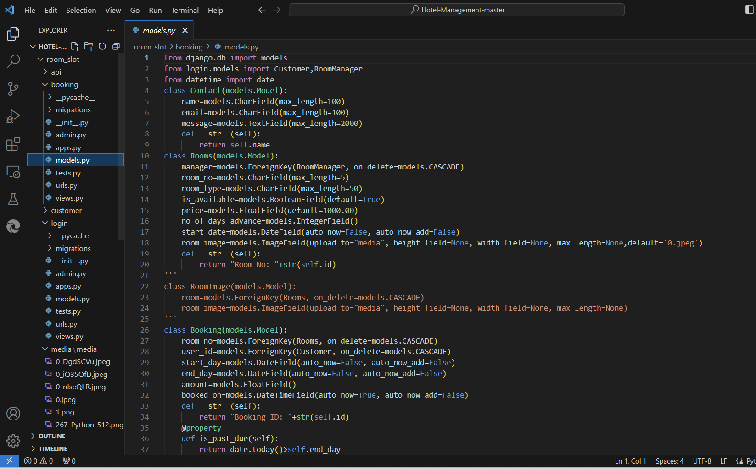

Slide 71


Slide 72
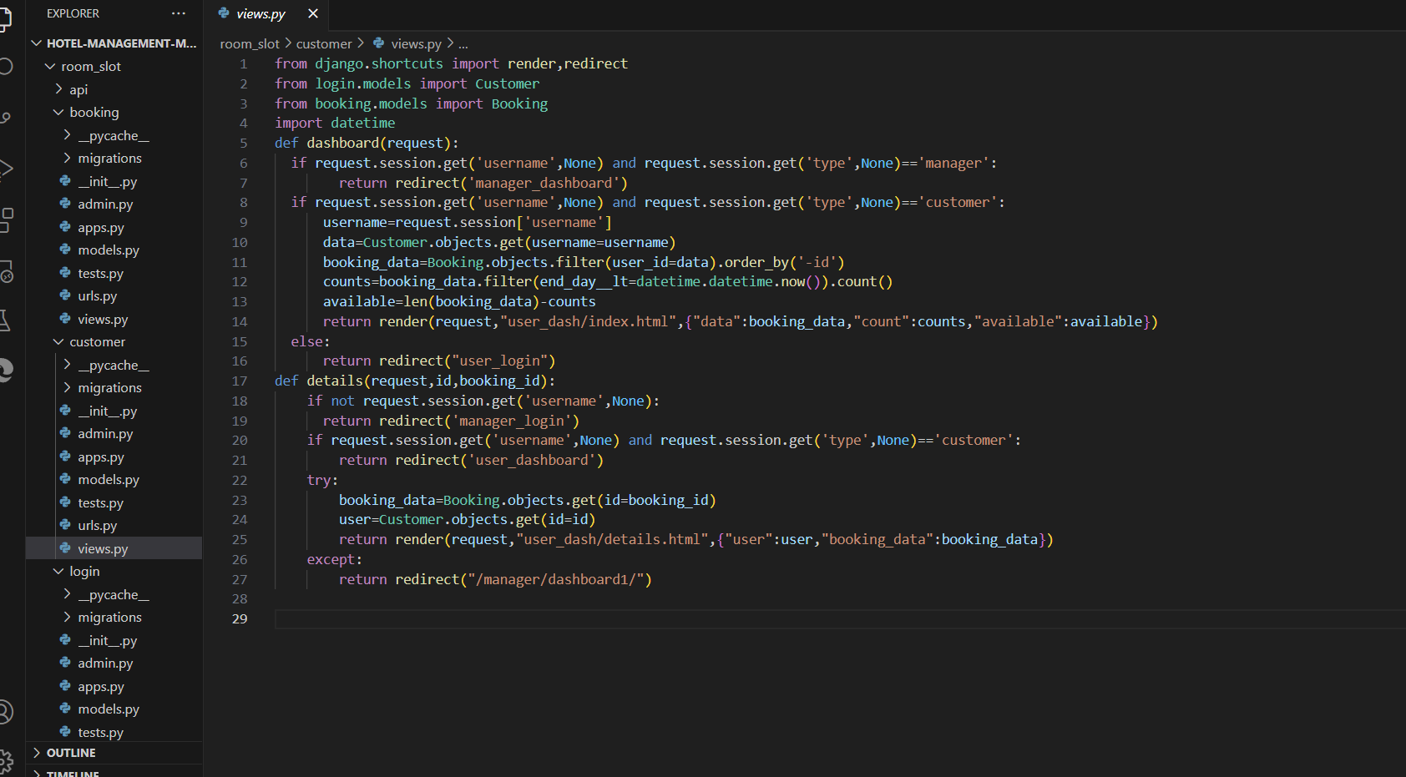

Slide 73
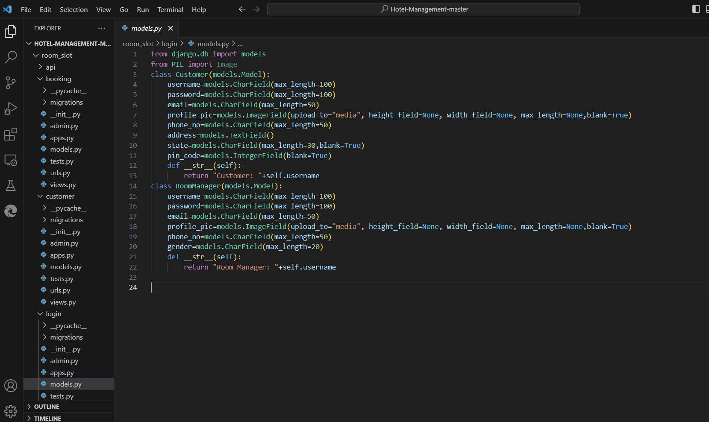

Slide 74
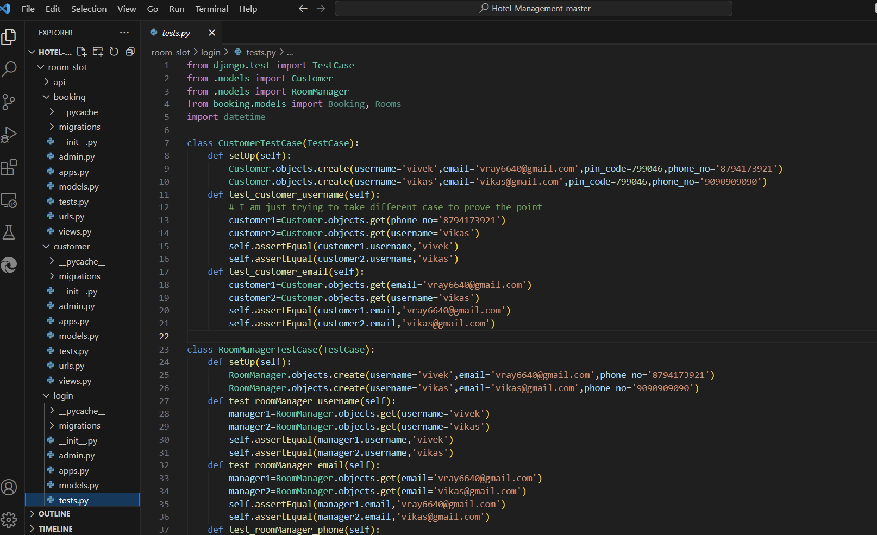

Slide 75
Pros
Hotel management systems streamline operations by offering features such as efficient reservation processes, integrated billing, and centralized guest profiles. These systems optimize room inventory management, facilitate housekeeping operations, and provide comprehensive reporting and analytics. With multi-channel reservation integration and guest service request functionalities, hotel management systems ensure a seamless and personalized guest experience. Additionally, they prioritize security and compliance, safeguarding guest data and maintaining industry standards.

Slide 76
pros
Enhancing staff productivity and communication.
Automating routine tasks like check-in/check-out procedures and billing.
Freeing up staff time to focus on delivering exceptional guest service.
Integrated inventory management and procurement modules for efficient supply management.
Control costs through effective management of supplies.
Robust reporting and analytics tools for data-driven decision-making.
Optimization of operations to maximize revenue.
Streamlining of hotel operations for increased efficiency.
Elevating guest satisfaction through improved service delivery.
Indispensable tools for modern hospitality businesses.

Slide 77
Cons
Cybersecurity Risks: E-commerce websites are vulnerable to data breaches and hacking, posing a risk to sensitive customer information.
Technical Difficulties: Website downtime or errors can occur, leading to a negative user experience and potential loss of sales.
Customer Service Challenges: Addressing product information, shipping inquiries, and order issues may pose challenges in providing satisfactory customer service.
Shipping and Fulfillment Logistics: Managing shipping logistics can be complex and time-consuming for e-commerce businesses, affecting operational efficiency.
Payment Processing Fees: E-commerce businesses incur fees for credit card transactions, impacting their profit margins.

Slide 78
Cons
Lack of Personal Touch: E-commerce lacks the personal interaction found in brick-and-mortar stores, hindering the development of customer relationships and loyalty.
High Competition: E-commerce is a competitive market, requiring businesses to continually innovate and adapt to remain competitive.

Slide 79
Future Works
Personalized Guest Experiences: Hotel management systems will focus on delivering personalized experiences tailored to individual guest preferences, enhancing overall satisfaction and loyalty.
Mobile-First Approach: With the increasing reliance on mobile devices, hotel management systems will prioritize mobile-friendly interfaces and functionalities to provide seamless experiences for guests booking and managing their stays.
Integration of Artificial Intelligence: AI-driven chatbots and voice assistants will be integrated into hotel management systems to streamline guest interactions, provide instant support, and enhance efficiency in handling guest requests.

Slide 80
Future Works
Augmented Reality for Virtual Experiences: Hotels will leverage augmented reality technology to offer virtual tours, allow guests to preview rooms and amenities, and enhance the booking process by providing immersive experiences.
Social Media Integration: Hotel management systems will integrate with social media platforms, enabling direct booking and engagement with guests through social channels, fostering stronger relationships and brand advocacy.
Voice Commerce Integration: The adoption of smart speakers and voice assistants will facilitate voice-enabled bookings, room service requests, and personalized recommendations, offering guests a convenient and hands-free way to interact with hotel services.

Slide 81
Customizable Room Options: Guests can choose from a variety of room options based on their preferences, such as room type, occupancy, and amenities.
Flexible Booking Management: Hotel staff can easily manage bookings, including modifying, cancelling, or rescheduling reservations, through a centralized dashboard.
Integrated Guest Feedback: The system integrates guest feedback mechanisms, allowing guests to provide reviews and ratings after their stay, facilitating continuous improvement in service quality.
Efficient Housekeeping Management: Hotel staff can efficiently manage room cleaning schedules and housekeeping tasks through the system, ensuring timely turnaround between guest stays.
Comprehensive Reporting and Analytics: Hotel management can access comprehensive reports and analytics on occupancy rates, revenue, guest demographics, and more, enabling data-driven decision-making.
Mobile Compatibility: The system is compatible with mobile devices, allowing guests to make reservations and access booking information on the go, enhancing convenience and accessibility.

Slide 82
Future Works
Data Analytics for Personalization: Hotel management systems will utilize data analytics to gain insights into guest behavior and preferences, enabling targeted marketing campaigns, tailored promotions, and personalized service offerings.
Contactless Solutions: In response to health and safety concerns, hotel management systems will incorporate contactless check-in/out, digital room keys, and mobile payments to minimize physical touchpoints and ensure a safe and hygienic environment for guests.
Sustainability Initiatives: Hotel management systems will support sustainability efforts by offering eco-friendly options, promoting energy conservation, and tracking carbon footprint metrics to align with guests' environmental values.

Slide 83
Conclusion
Hotel management systems have revolutionized the hospitality industry by streamlining operations, enhancing guest experiences, and maximizing revenue opportunities. These systems offer comprehensive solutions for various hotel functions, including reservations, check-in/out, housekeeping, billing, and guest services. By centralizing data and automating tasks, hotel management systems improve efficiency, accuracy, and productivity, allowing staff to focus on delivering exceptional service to guests. With the integration of advanced technologies such as mobile apps, cloud computing, and data analytics, hotel management systems empower hoteliers to optimize operations, personalize guest interactions, and make data-driven decisions for better business outcomes. In today's competitive hospitality landscape, adopting a robust hotel management system is essential for hotels to stay ahead, meet evolving guest expectations, and achieve sustainable growth.

Slide 84


